Slide 1


Nebraska Drought Conditions:
CARC Update
November 28, 2022
Brian Fuchs
National Drought Mitigation Center
University of Nebraska-Lincoln
School of Natural Resources

Slide 2
Regional Climatic and Drought Conditions…

Slide 3
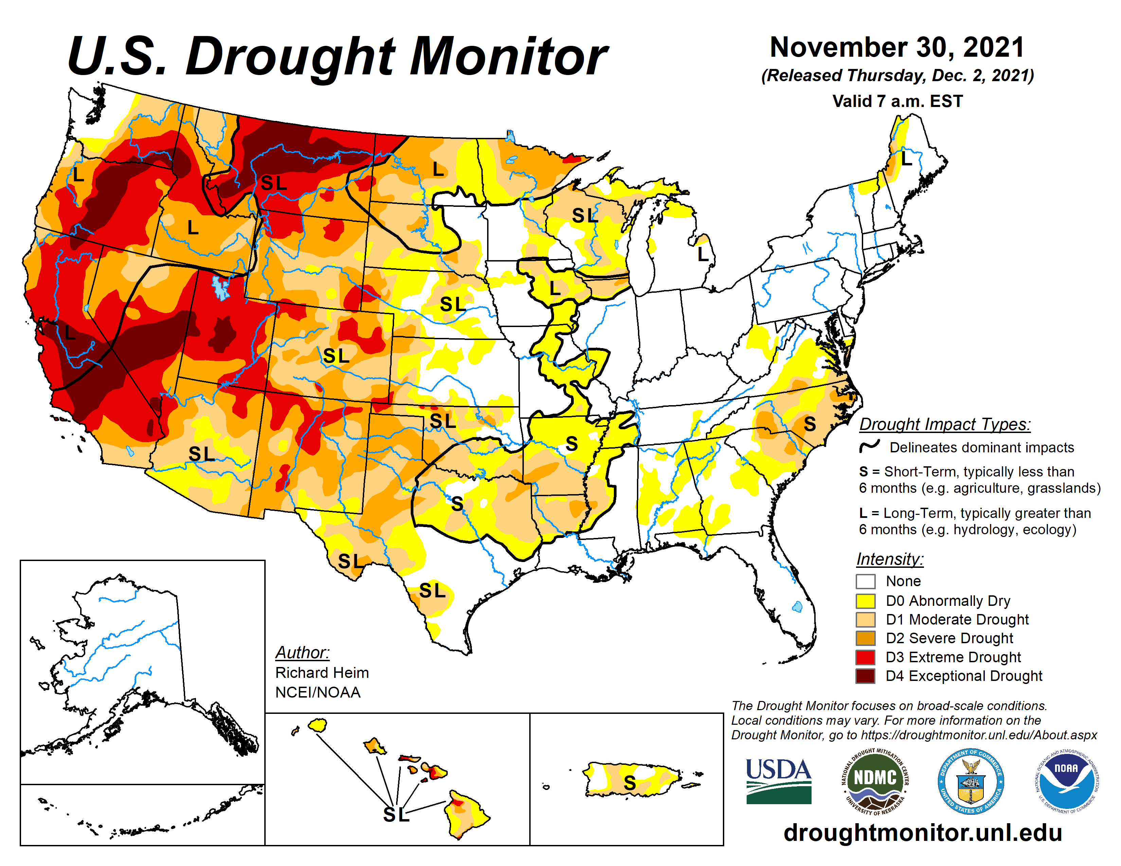
Last year at this time…..

Slide 4
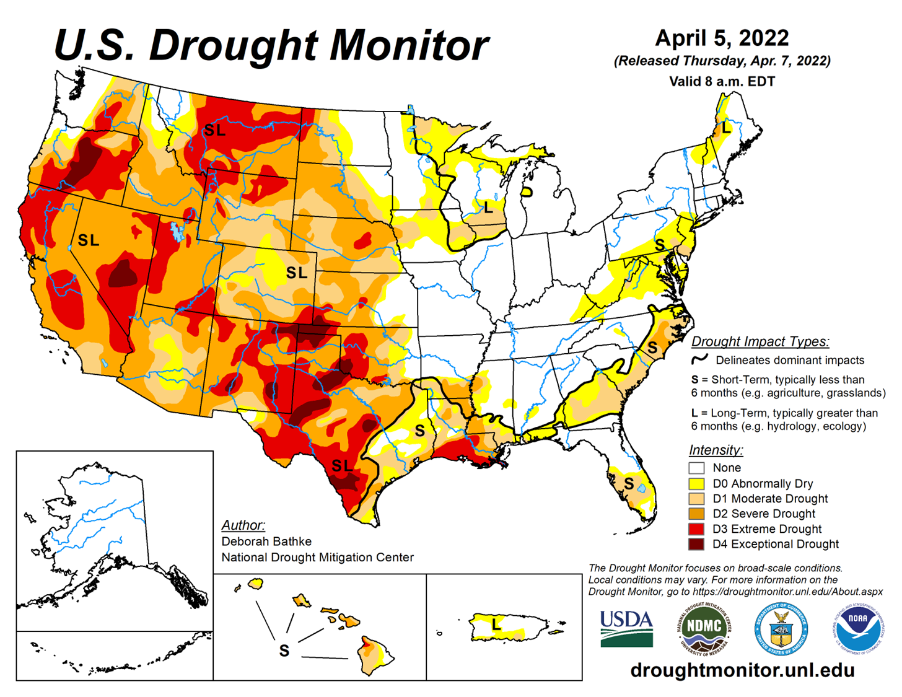
Last CARC Meeting…..

Slide 5
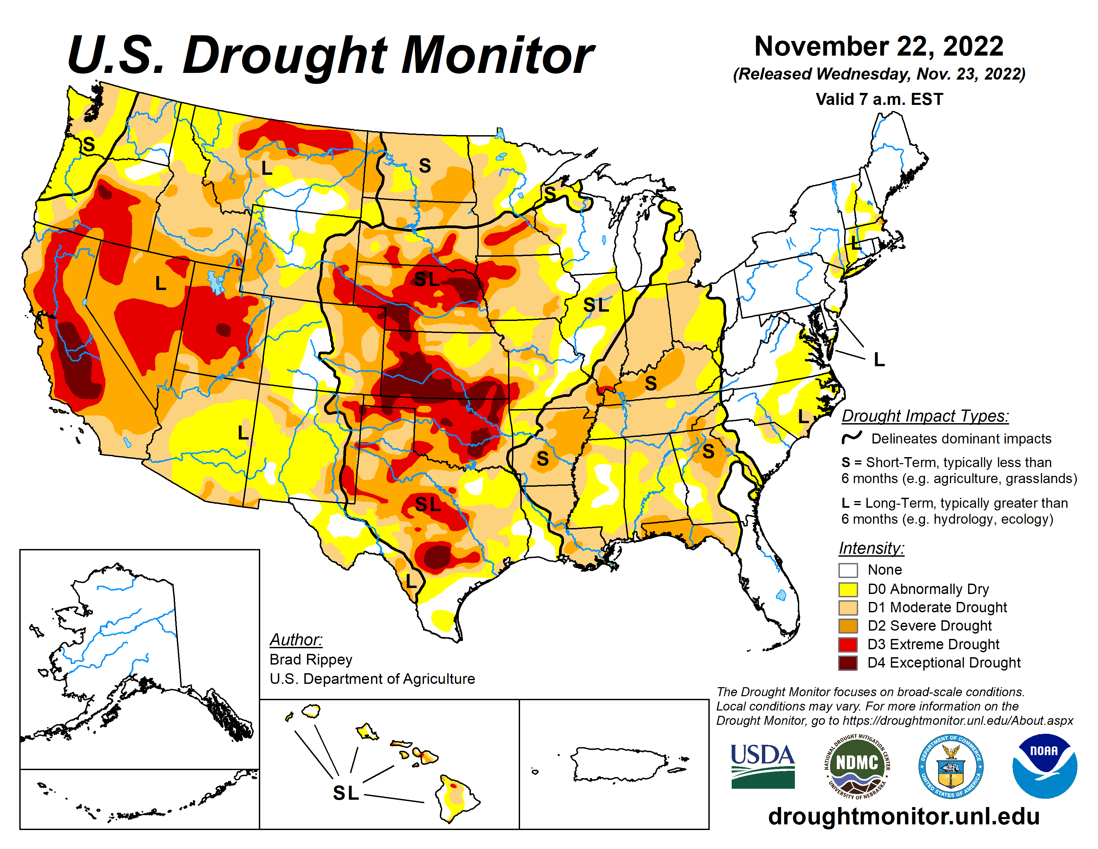

Slide 6
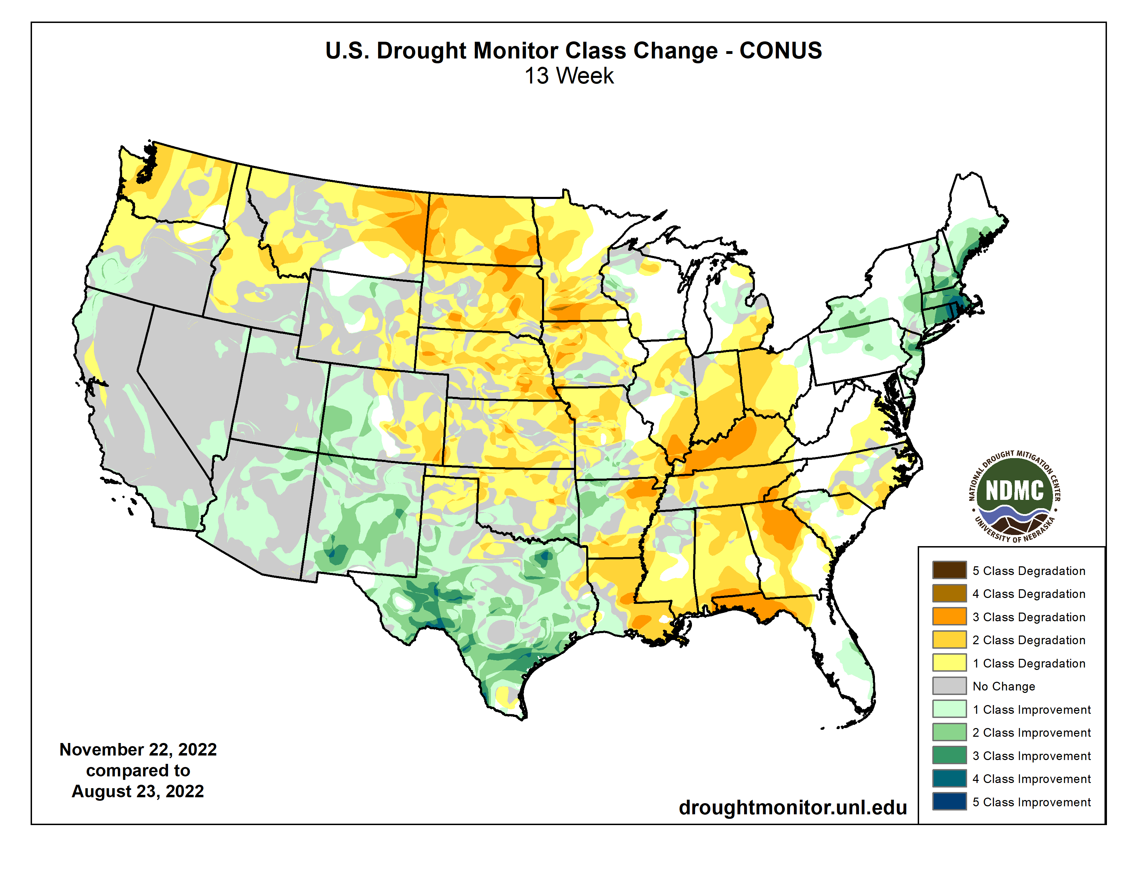

Slide 7
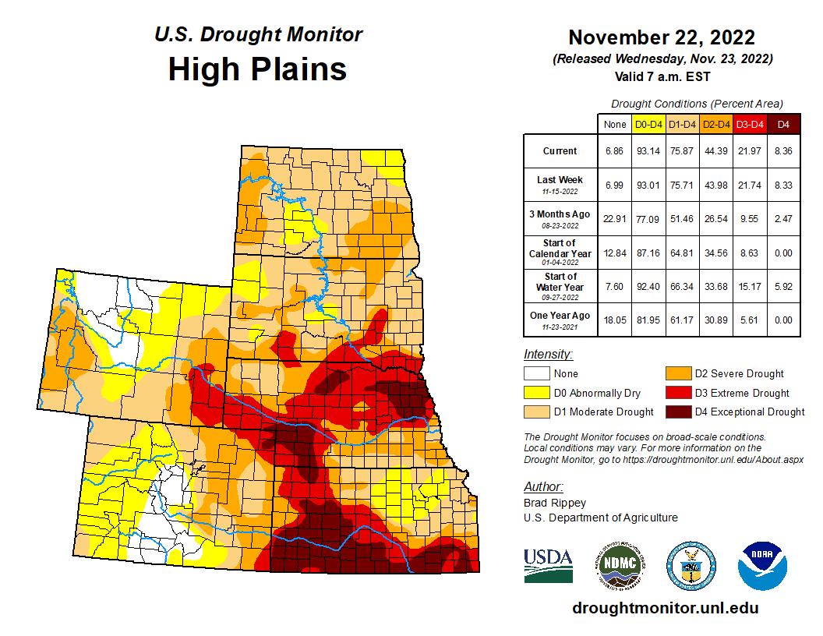


Slide 9
Last CARC meeting

Slide 10
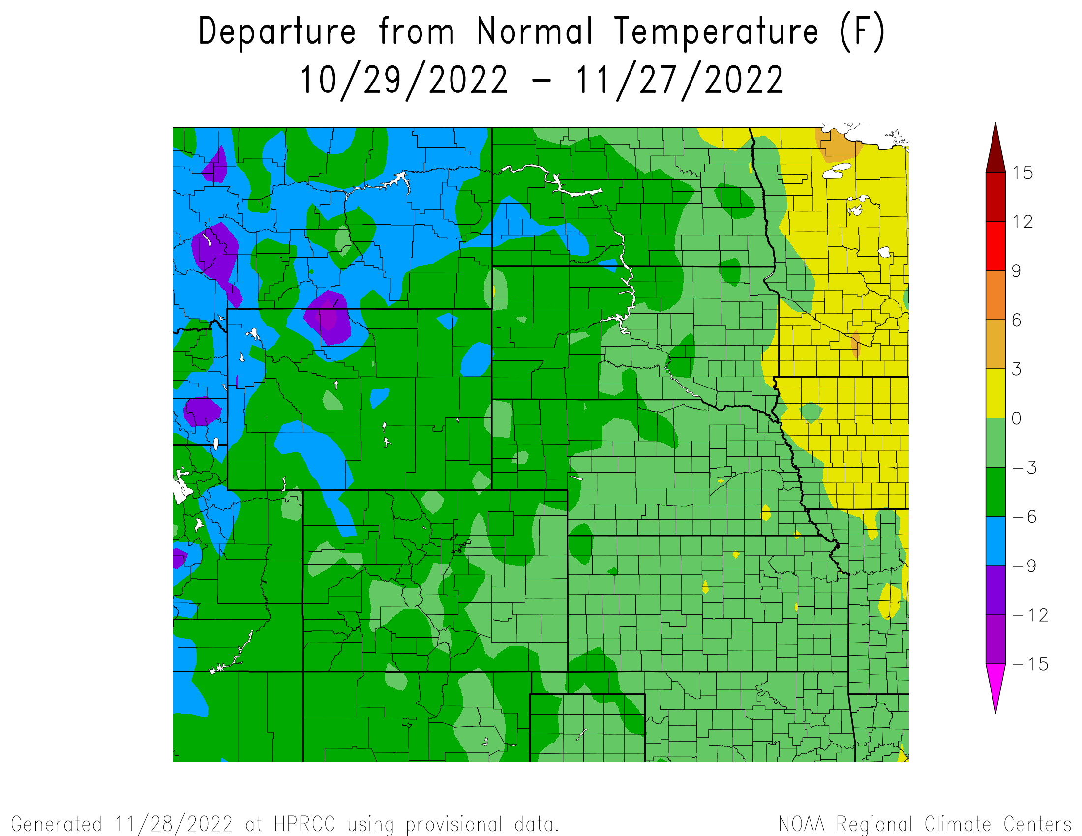
Departure from Normal Temperatures over the last 30 days

Slide 11
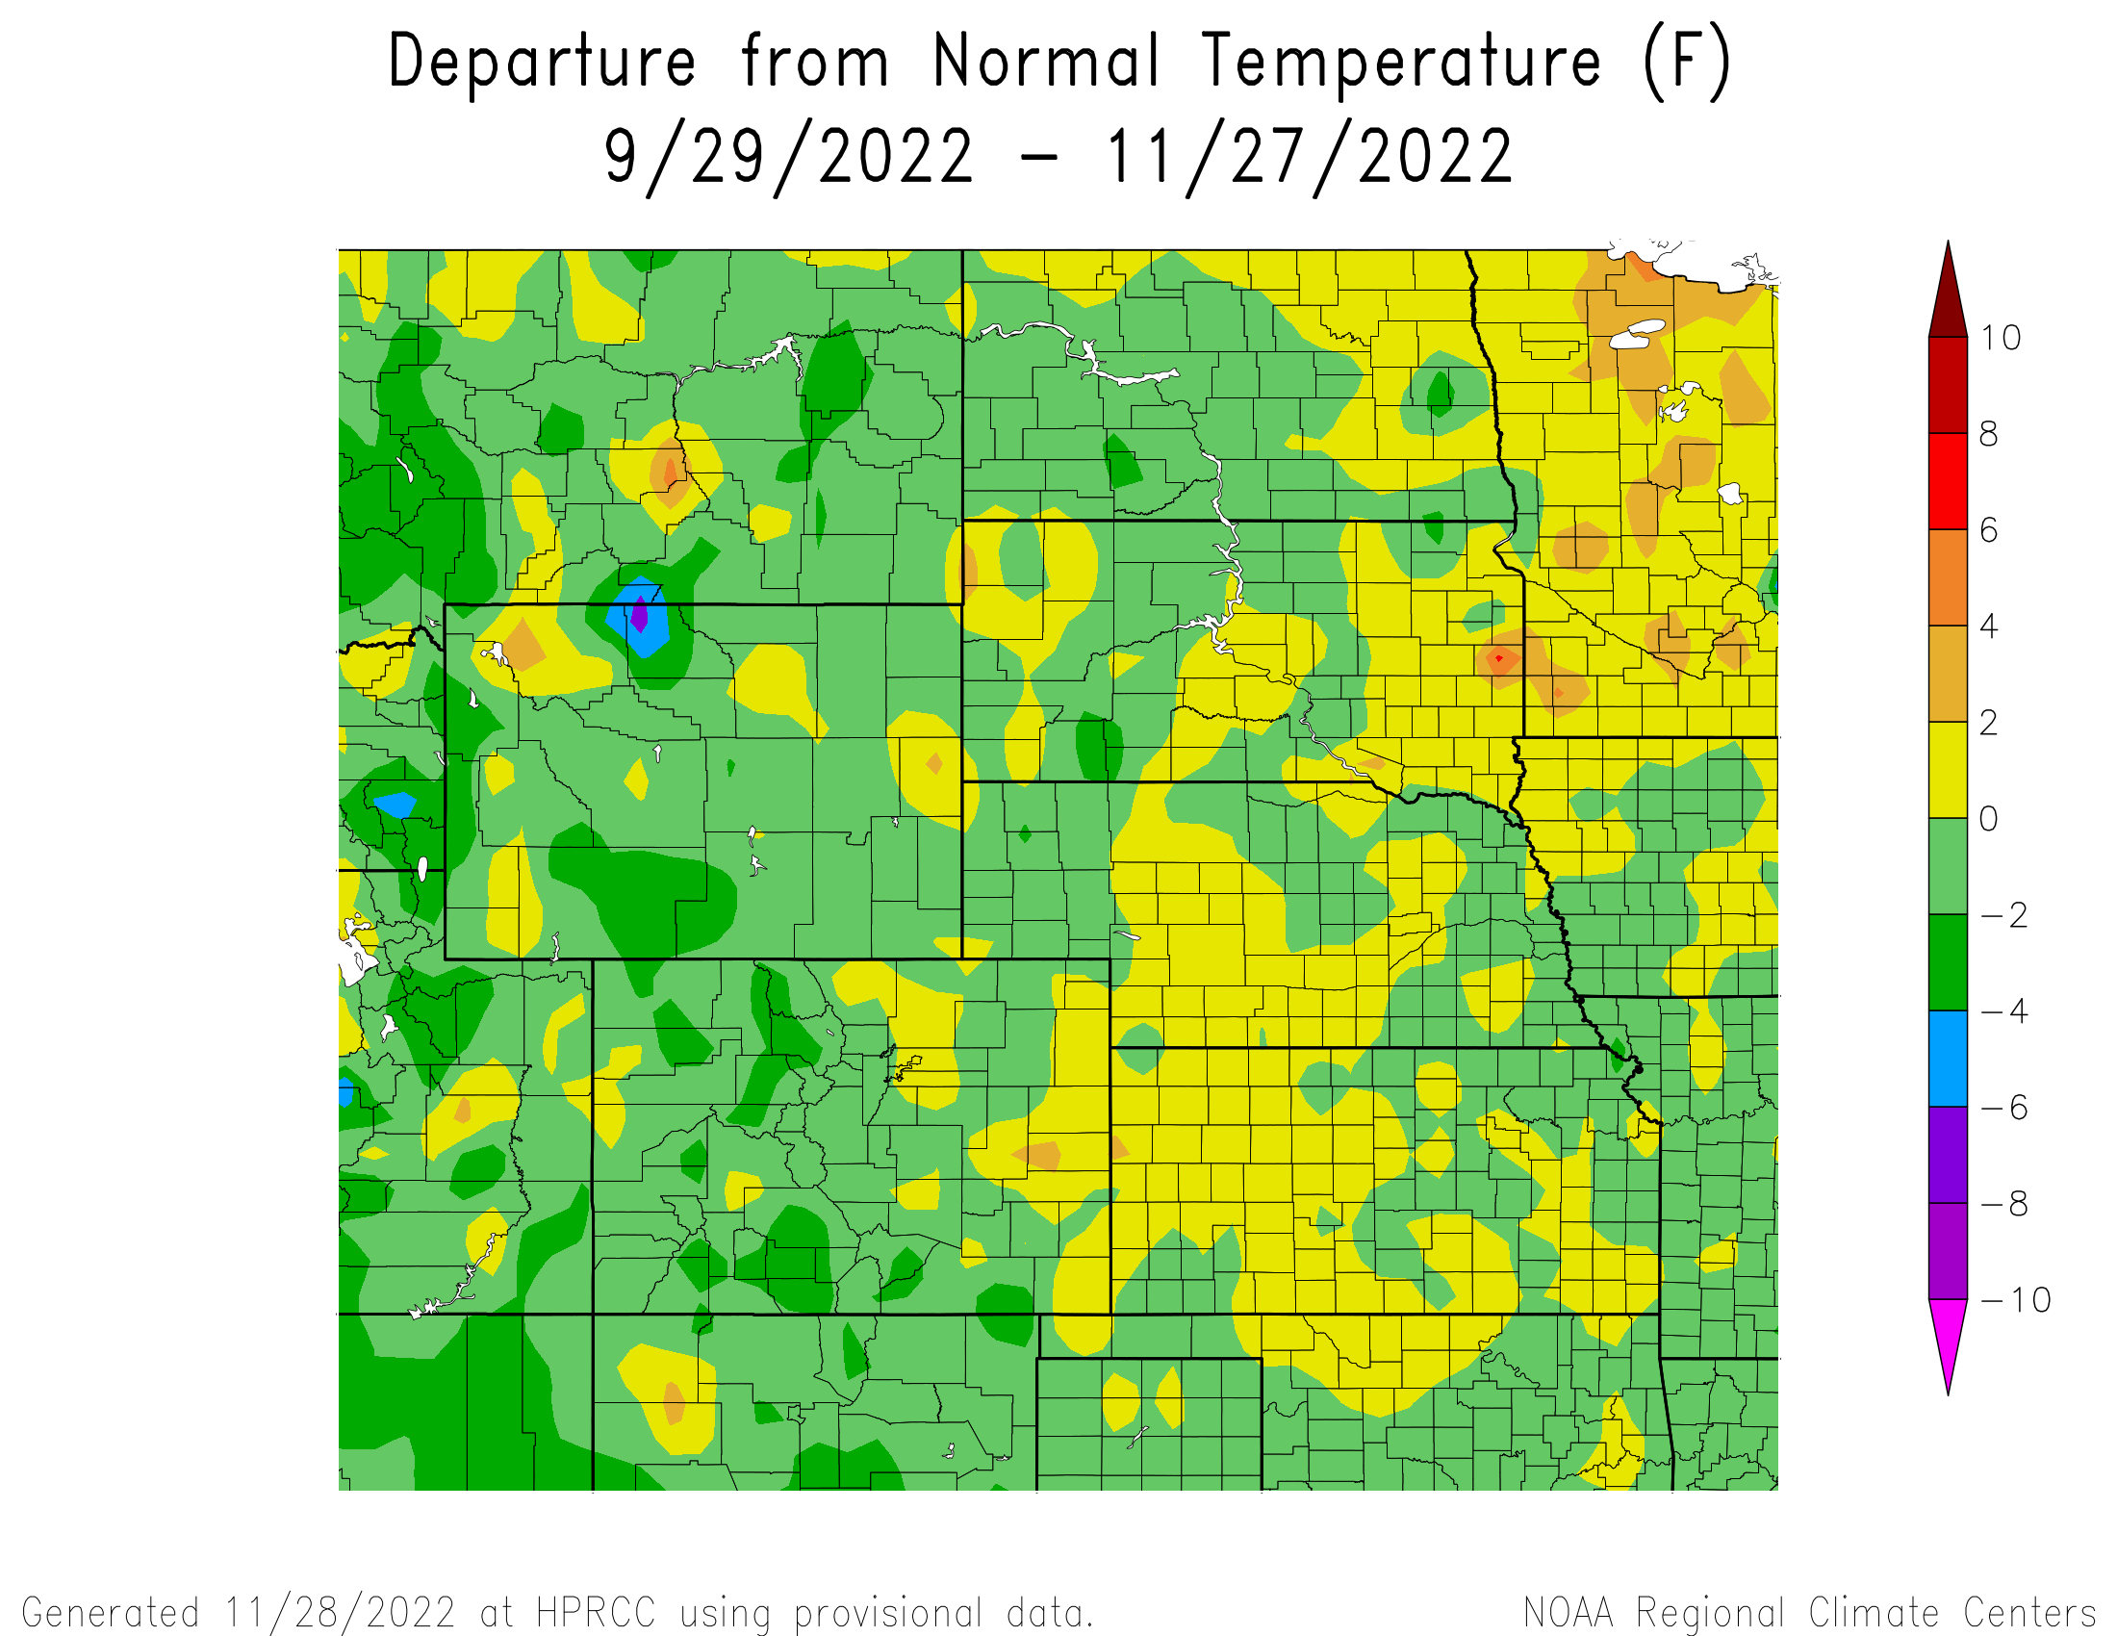
Departure from Normal Temperatures over the last 60 days

Slide 12
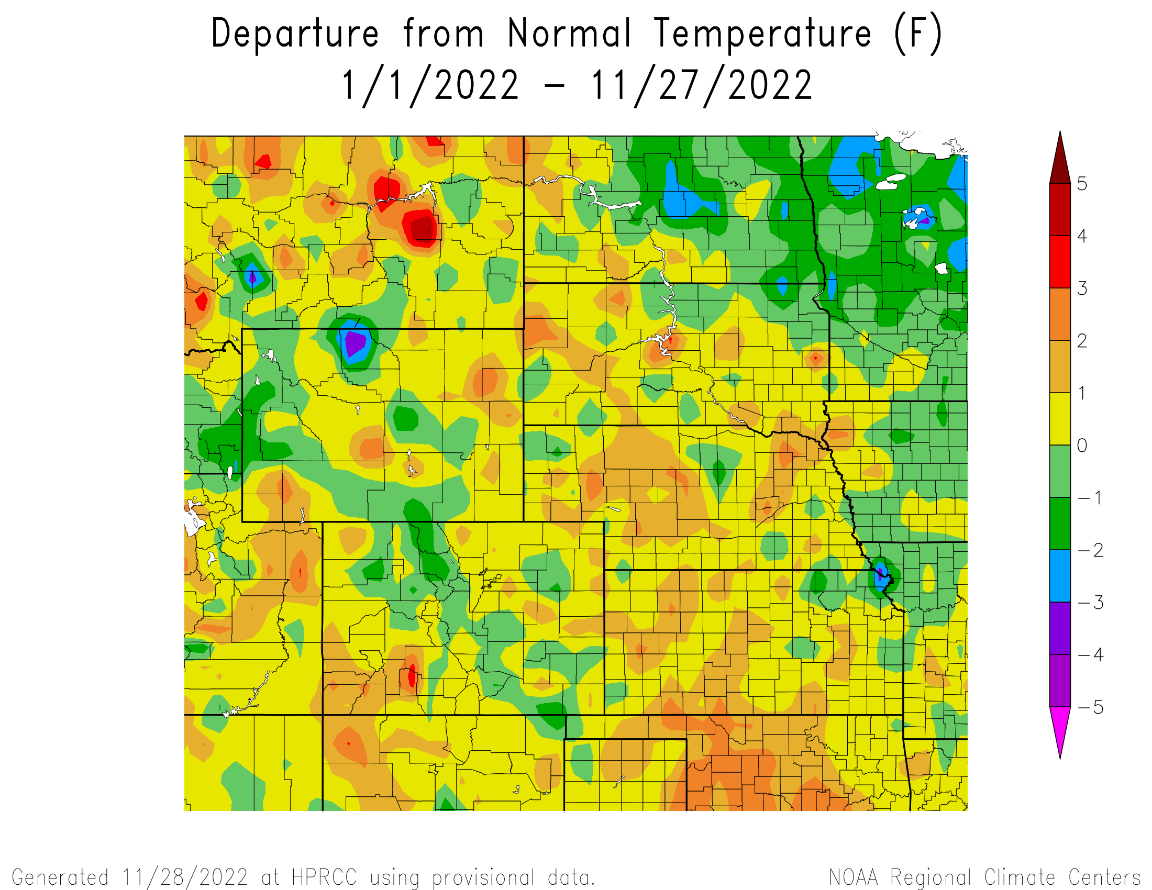
Departure from Normal Temperatures for the Calendar Year

Slide 13
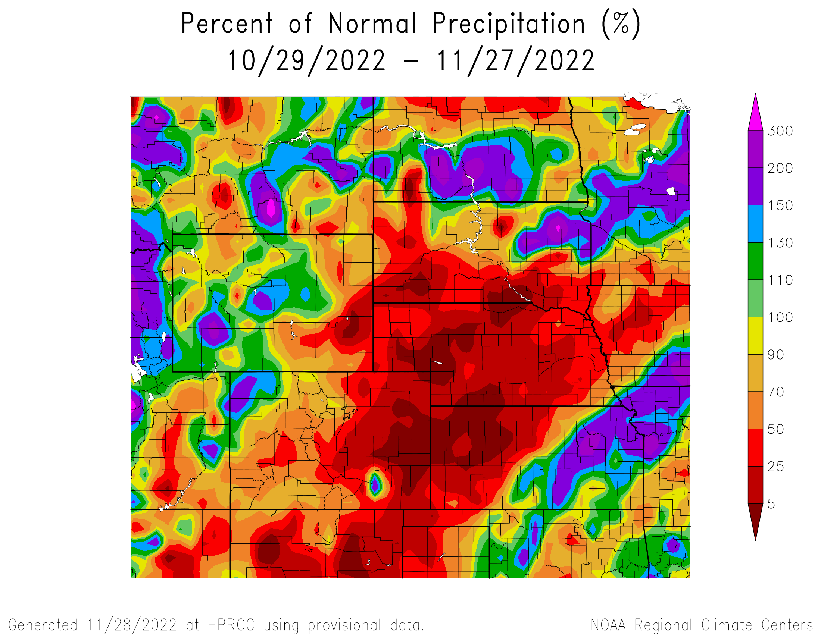
Percent of Normal Precipitation over the last 30 days

Slide 14
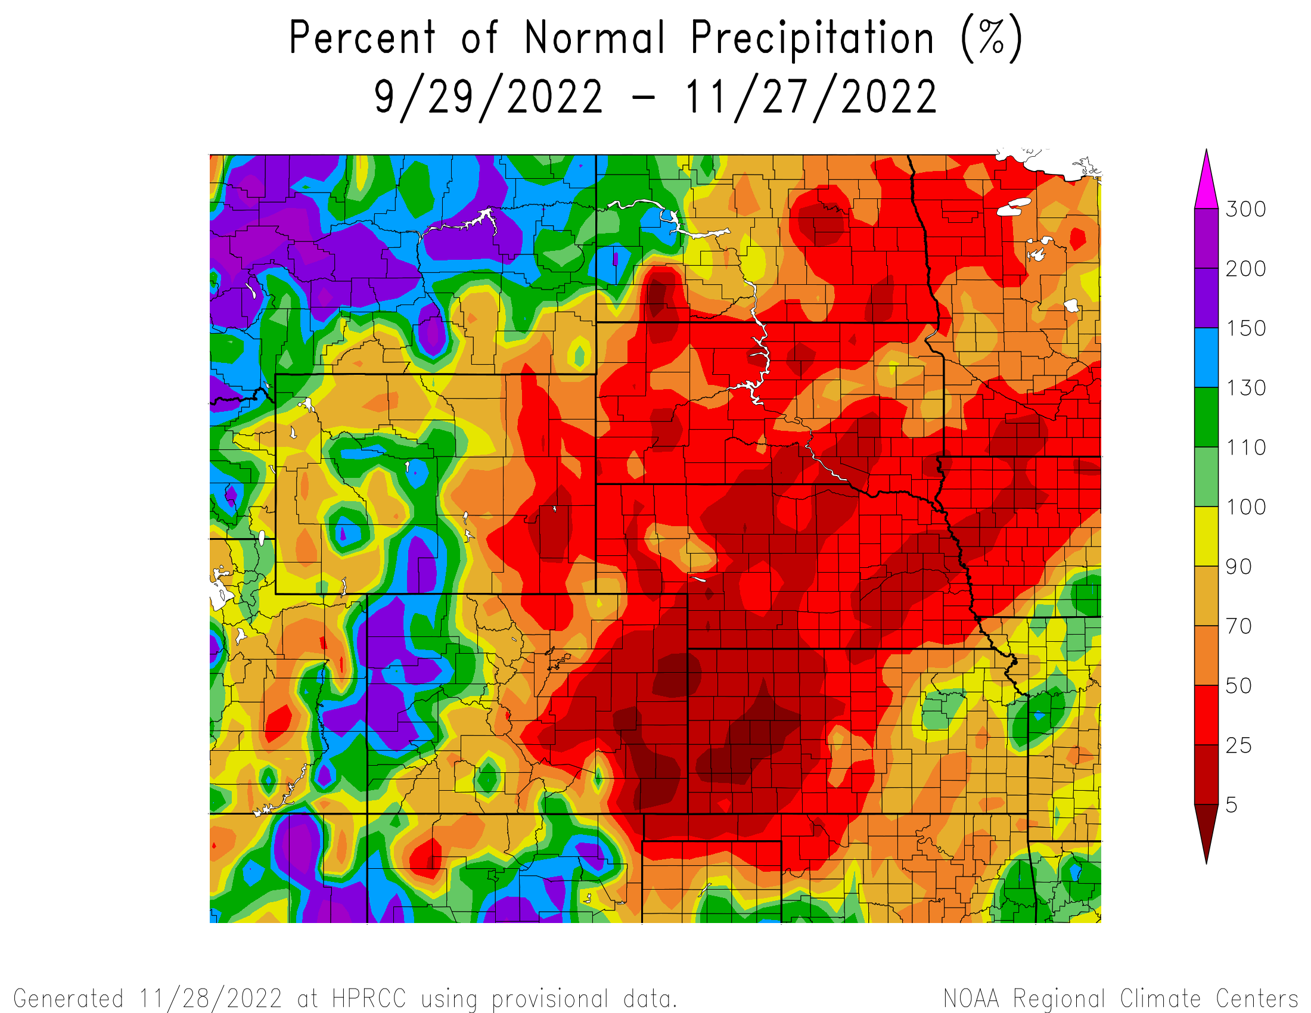
Percent of Normal Precipitation over the last 60 days

Slide 15
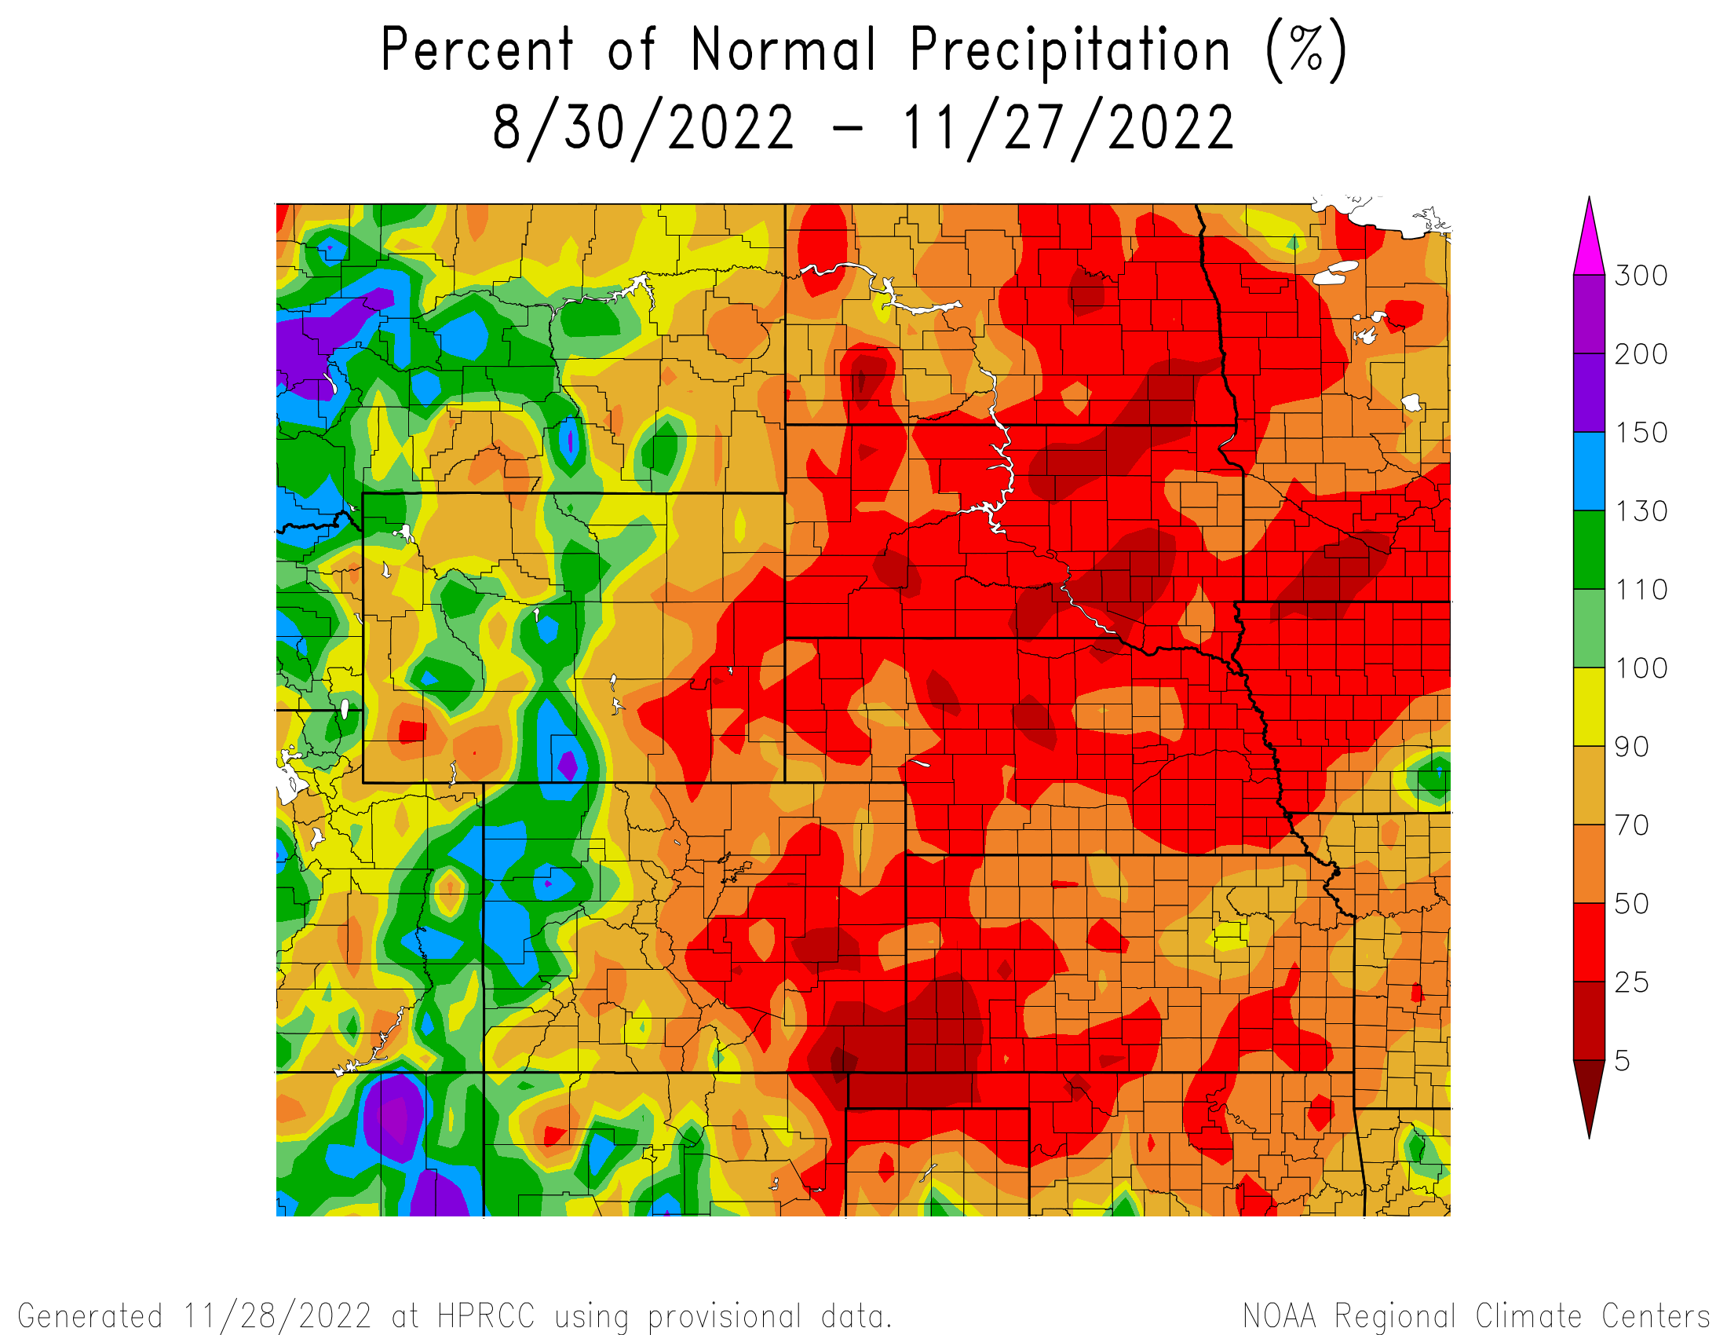
Percent of Normal Precipitation over the last 90 days

Slide 16
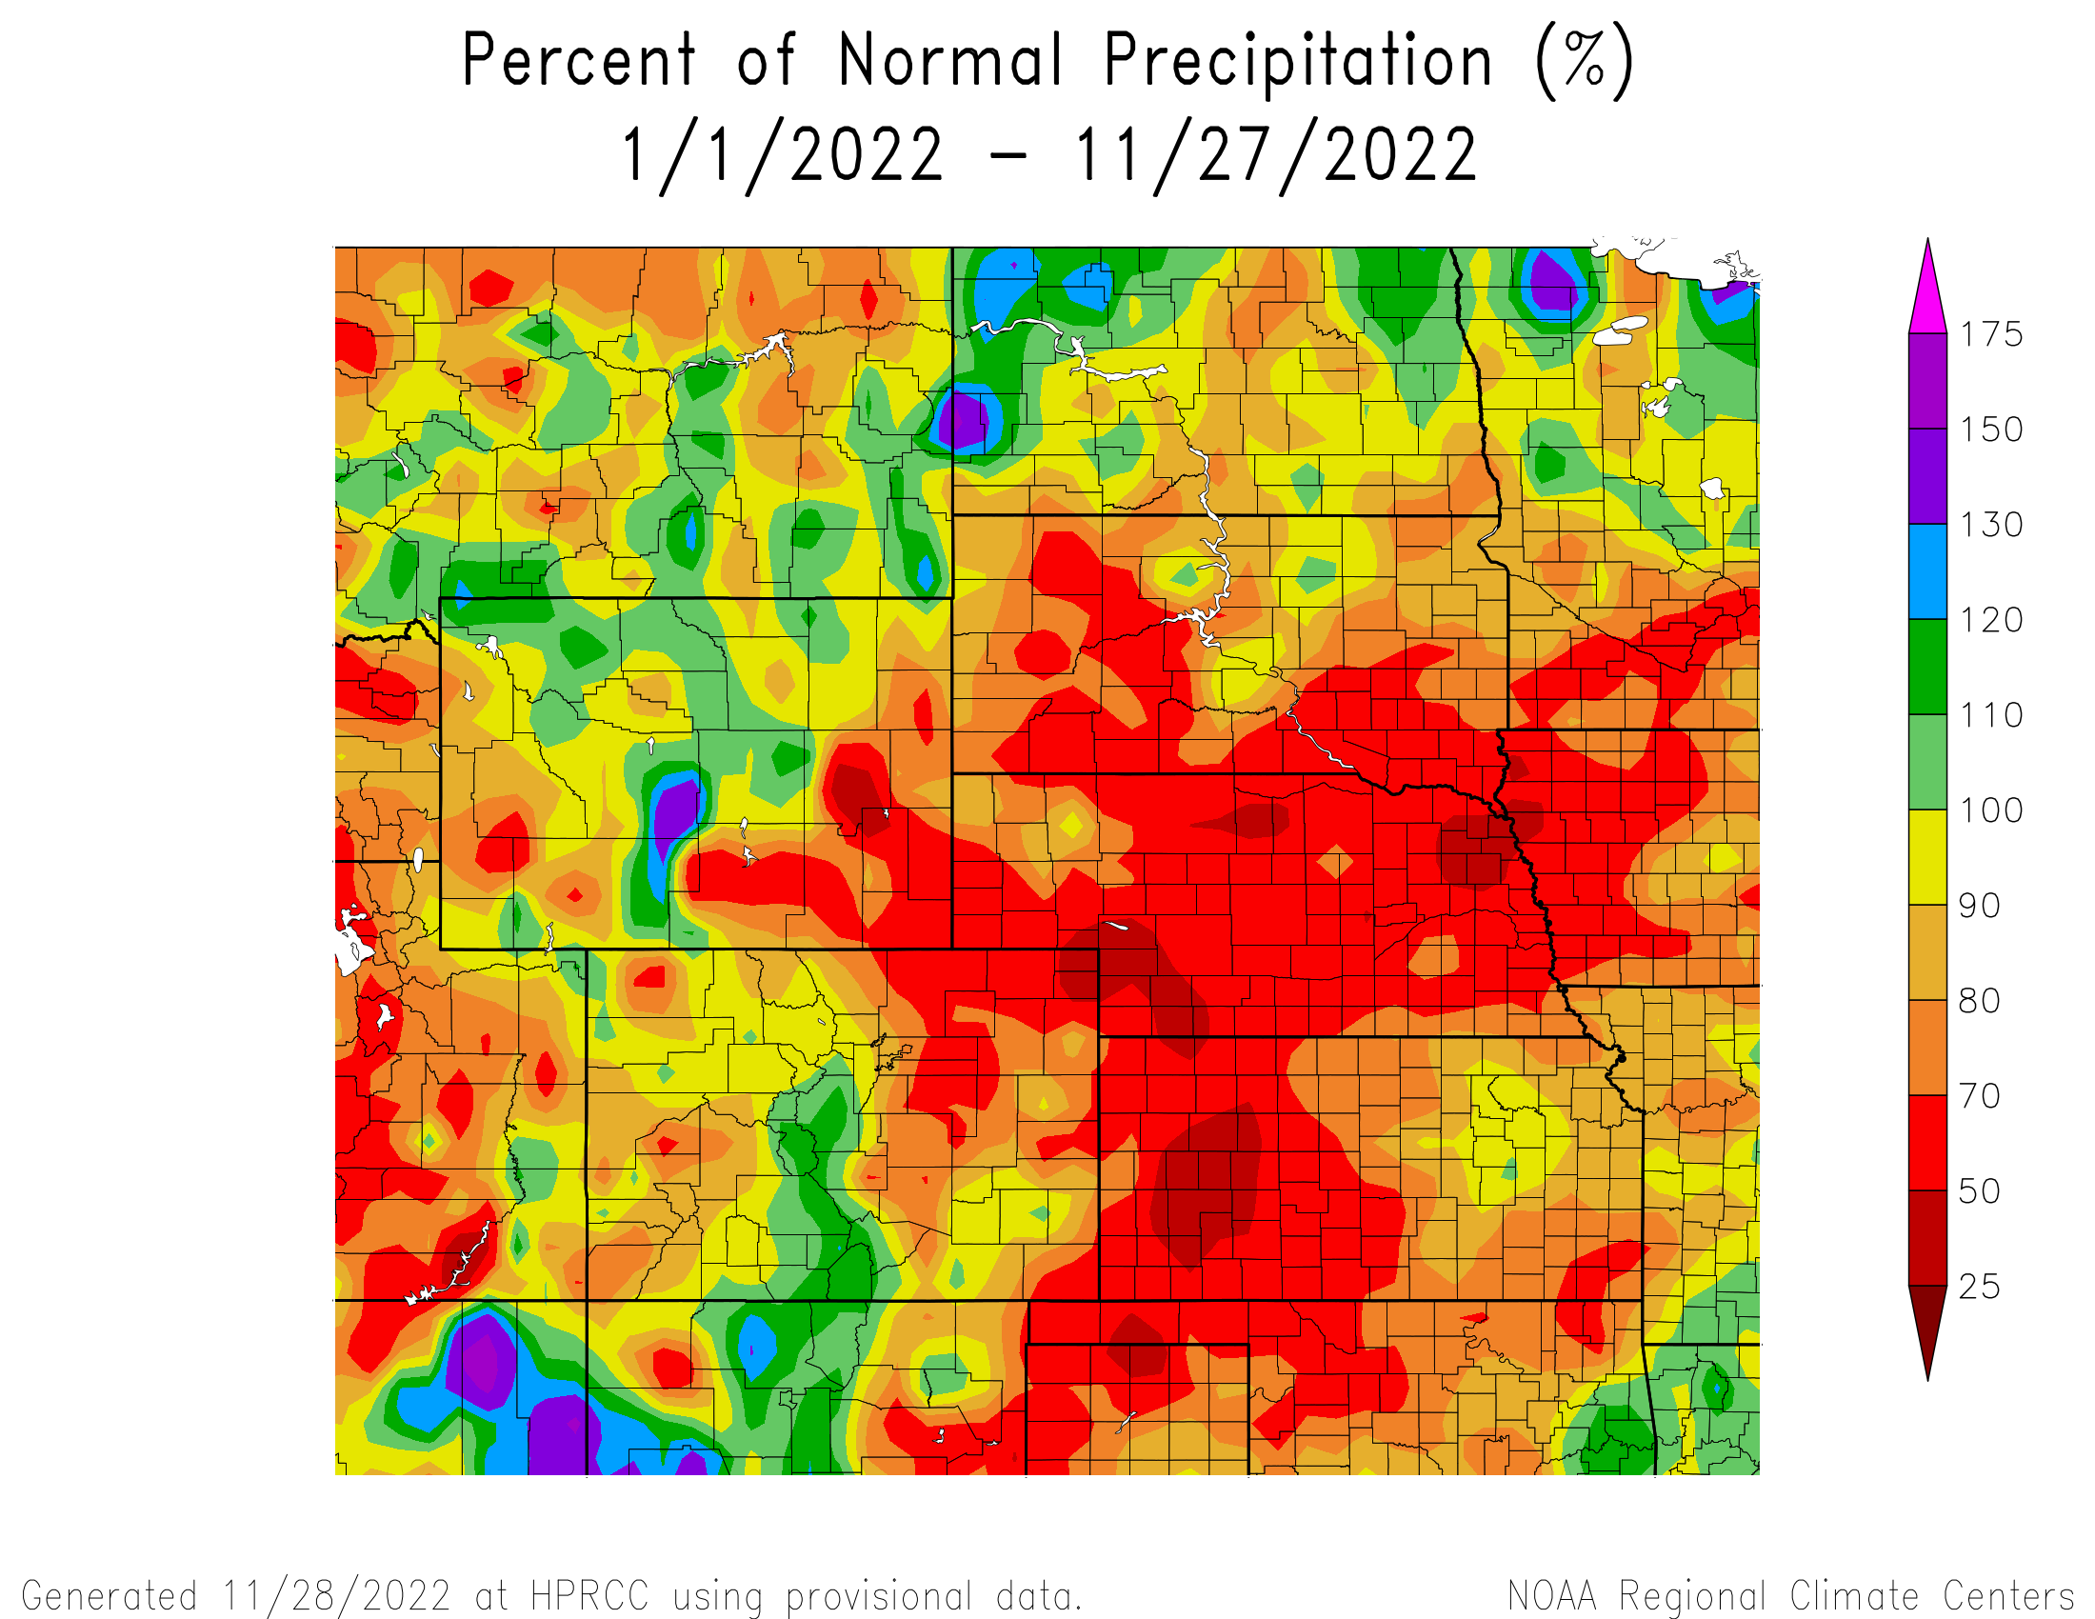
Percent of Normal Precipitation for the calendar year

Slide 17
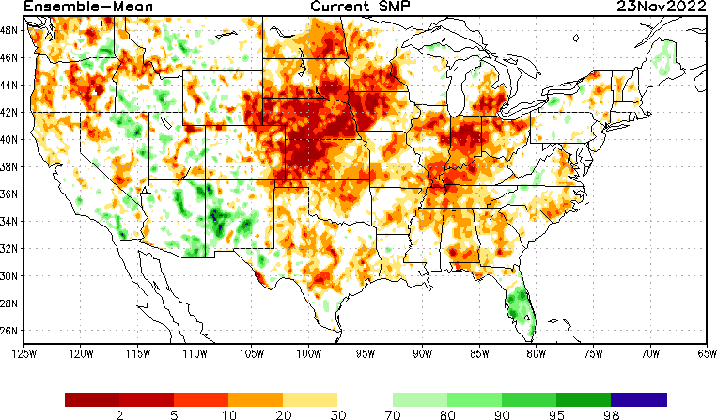
NLDAS Soil Moisture Model: Current Soil Moisture Anomaly

Slide 18
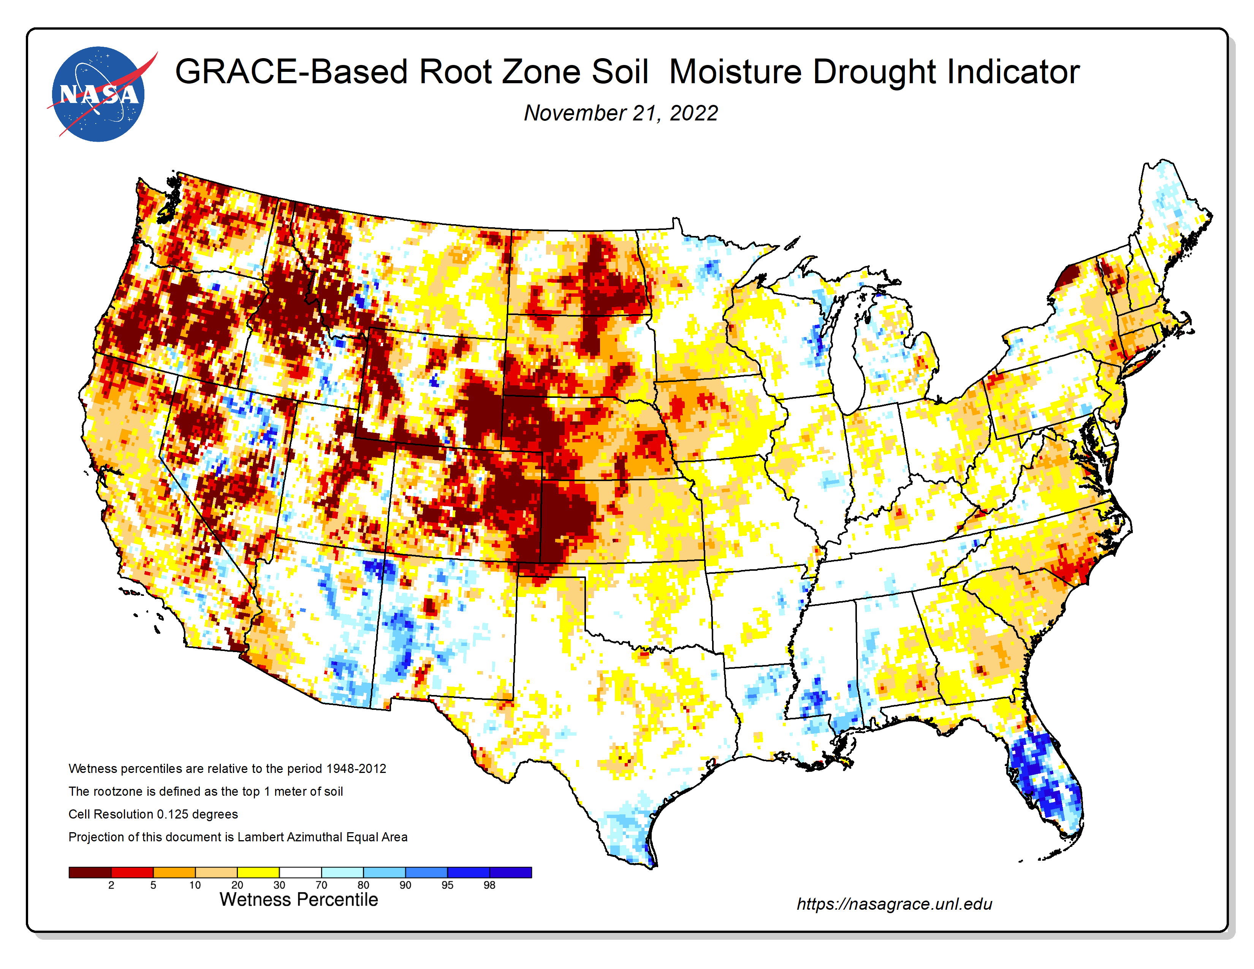
NASA GRACE-Based Root Zone Soil Moisture
https://nasagrace.unl.edu/

Slide 19
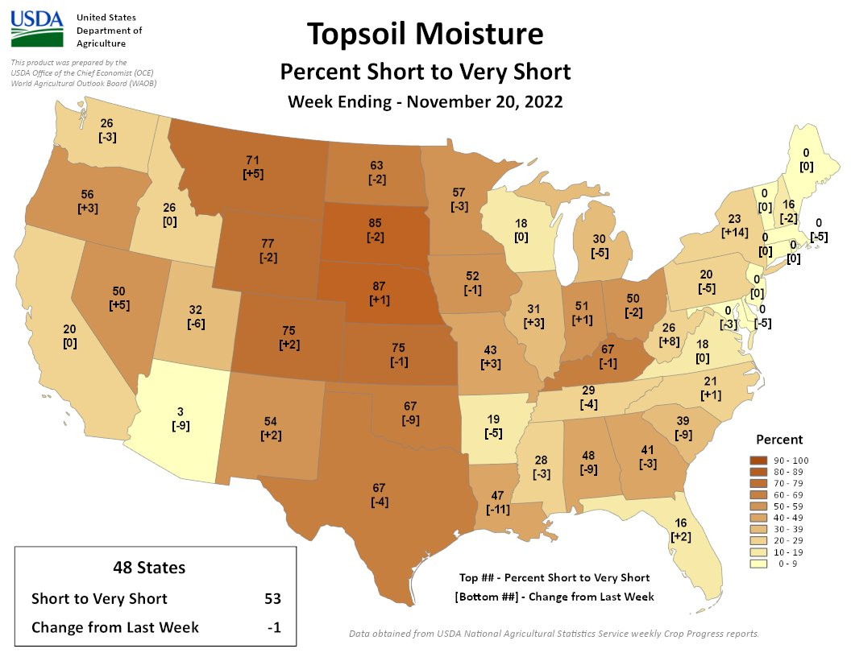

Slide 20
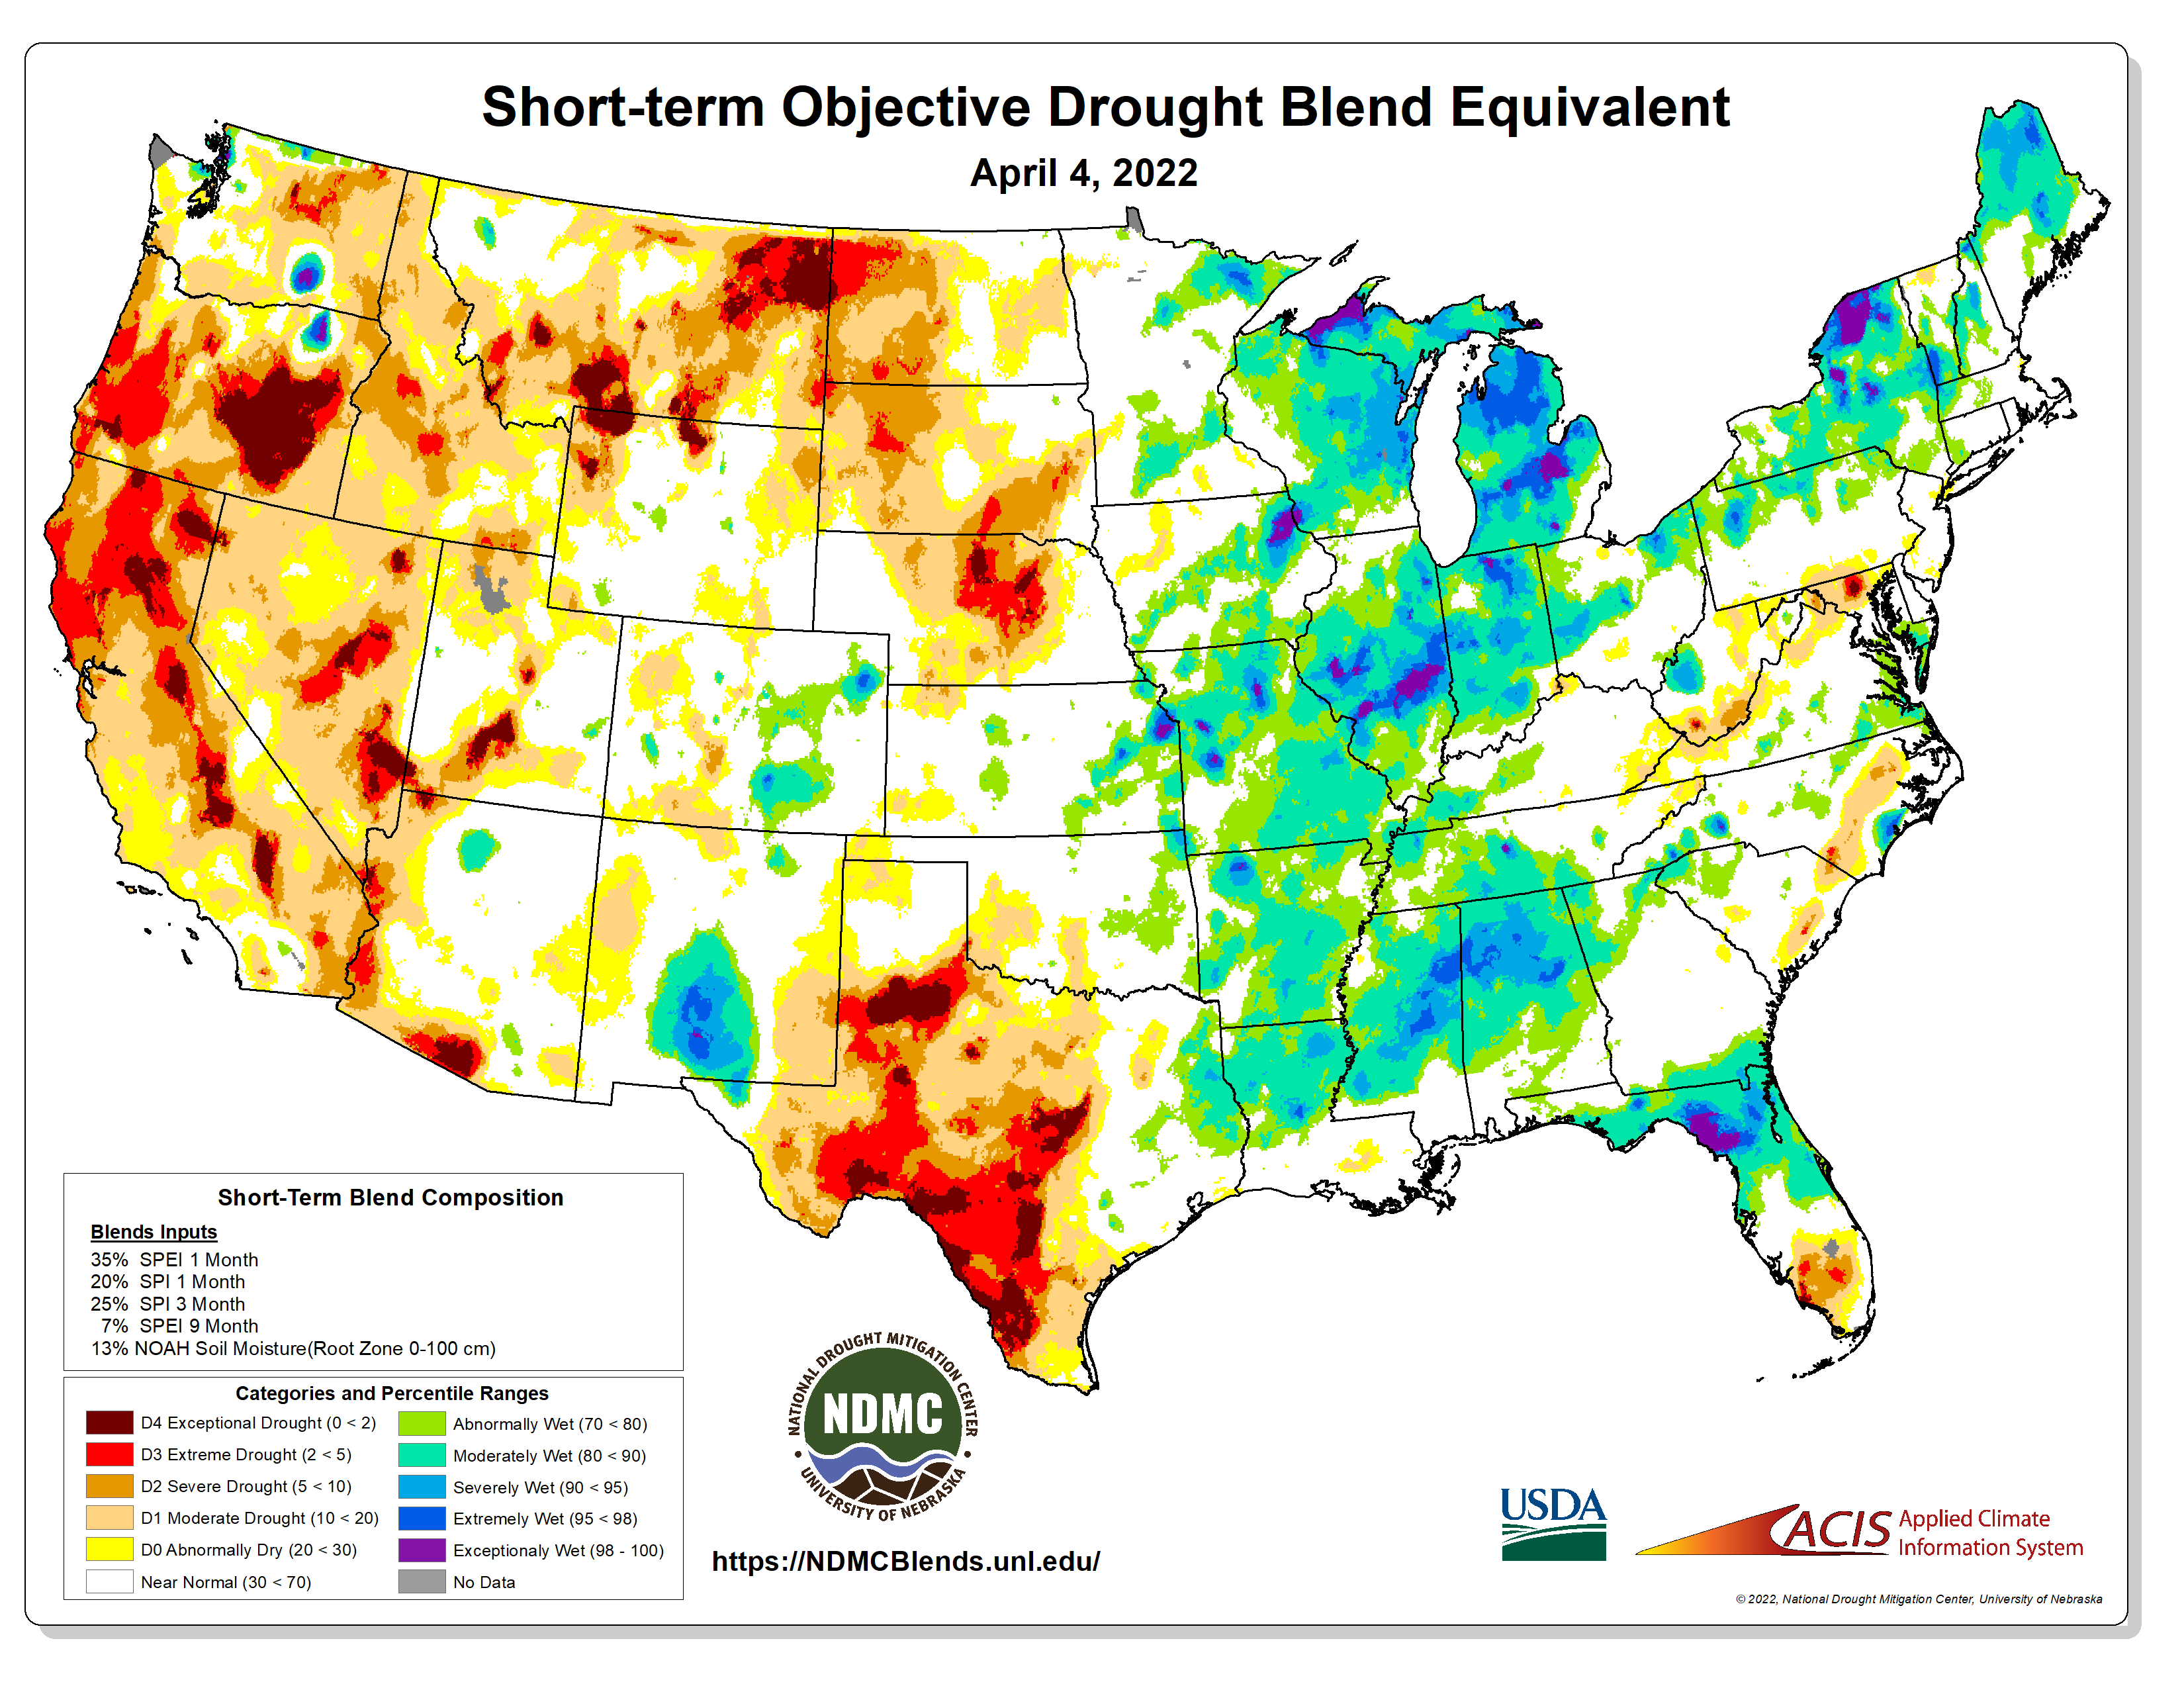
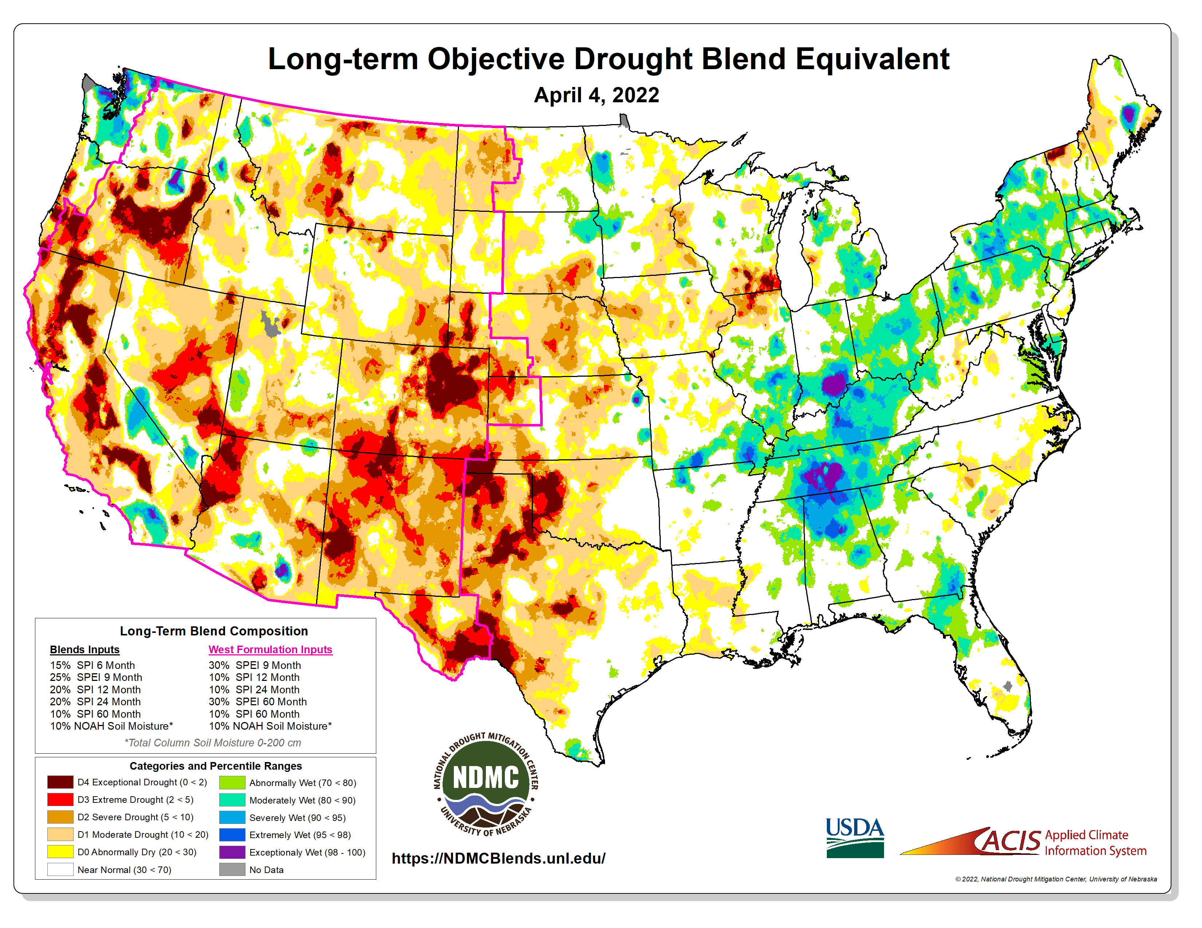
https://ndmcblends.unl.edu/
NDMC’s weekly Objective Blends for both short-term and long-term drought

Slide 21
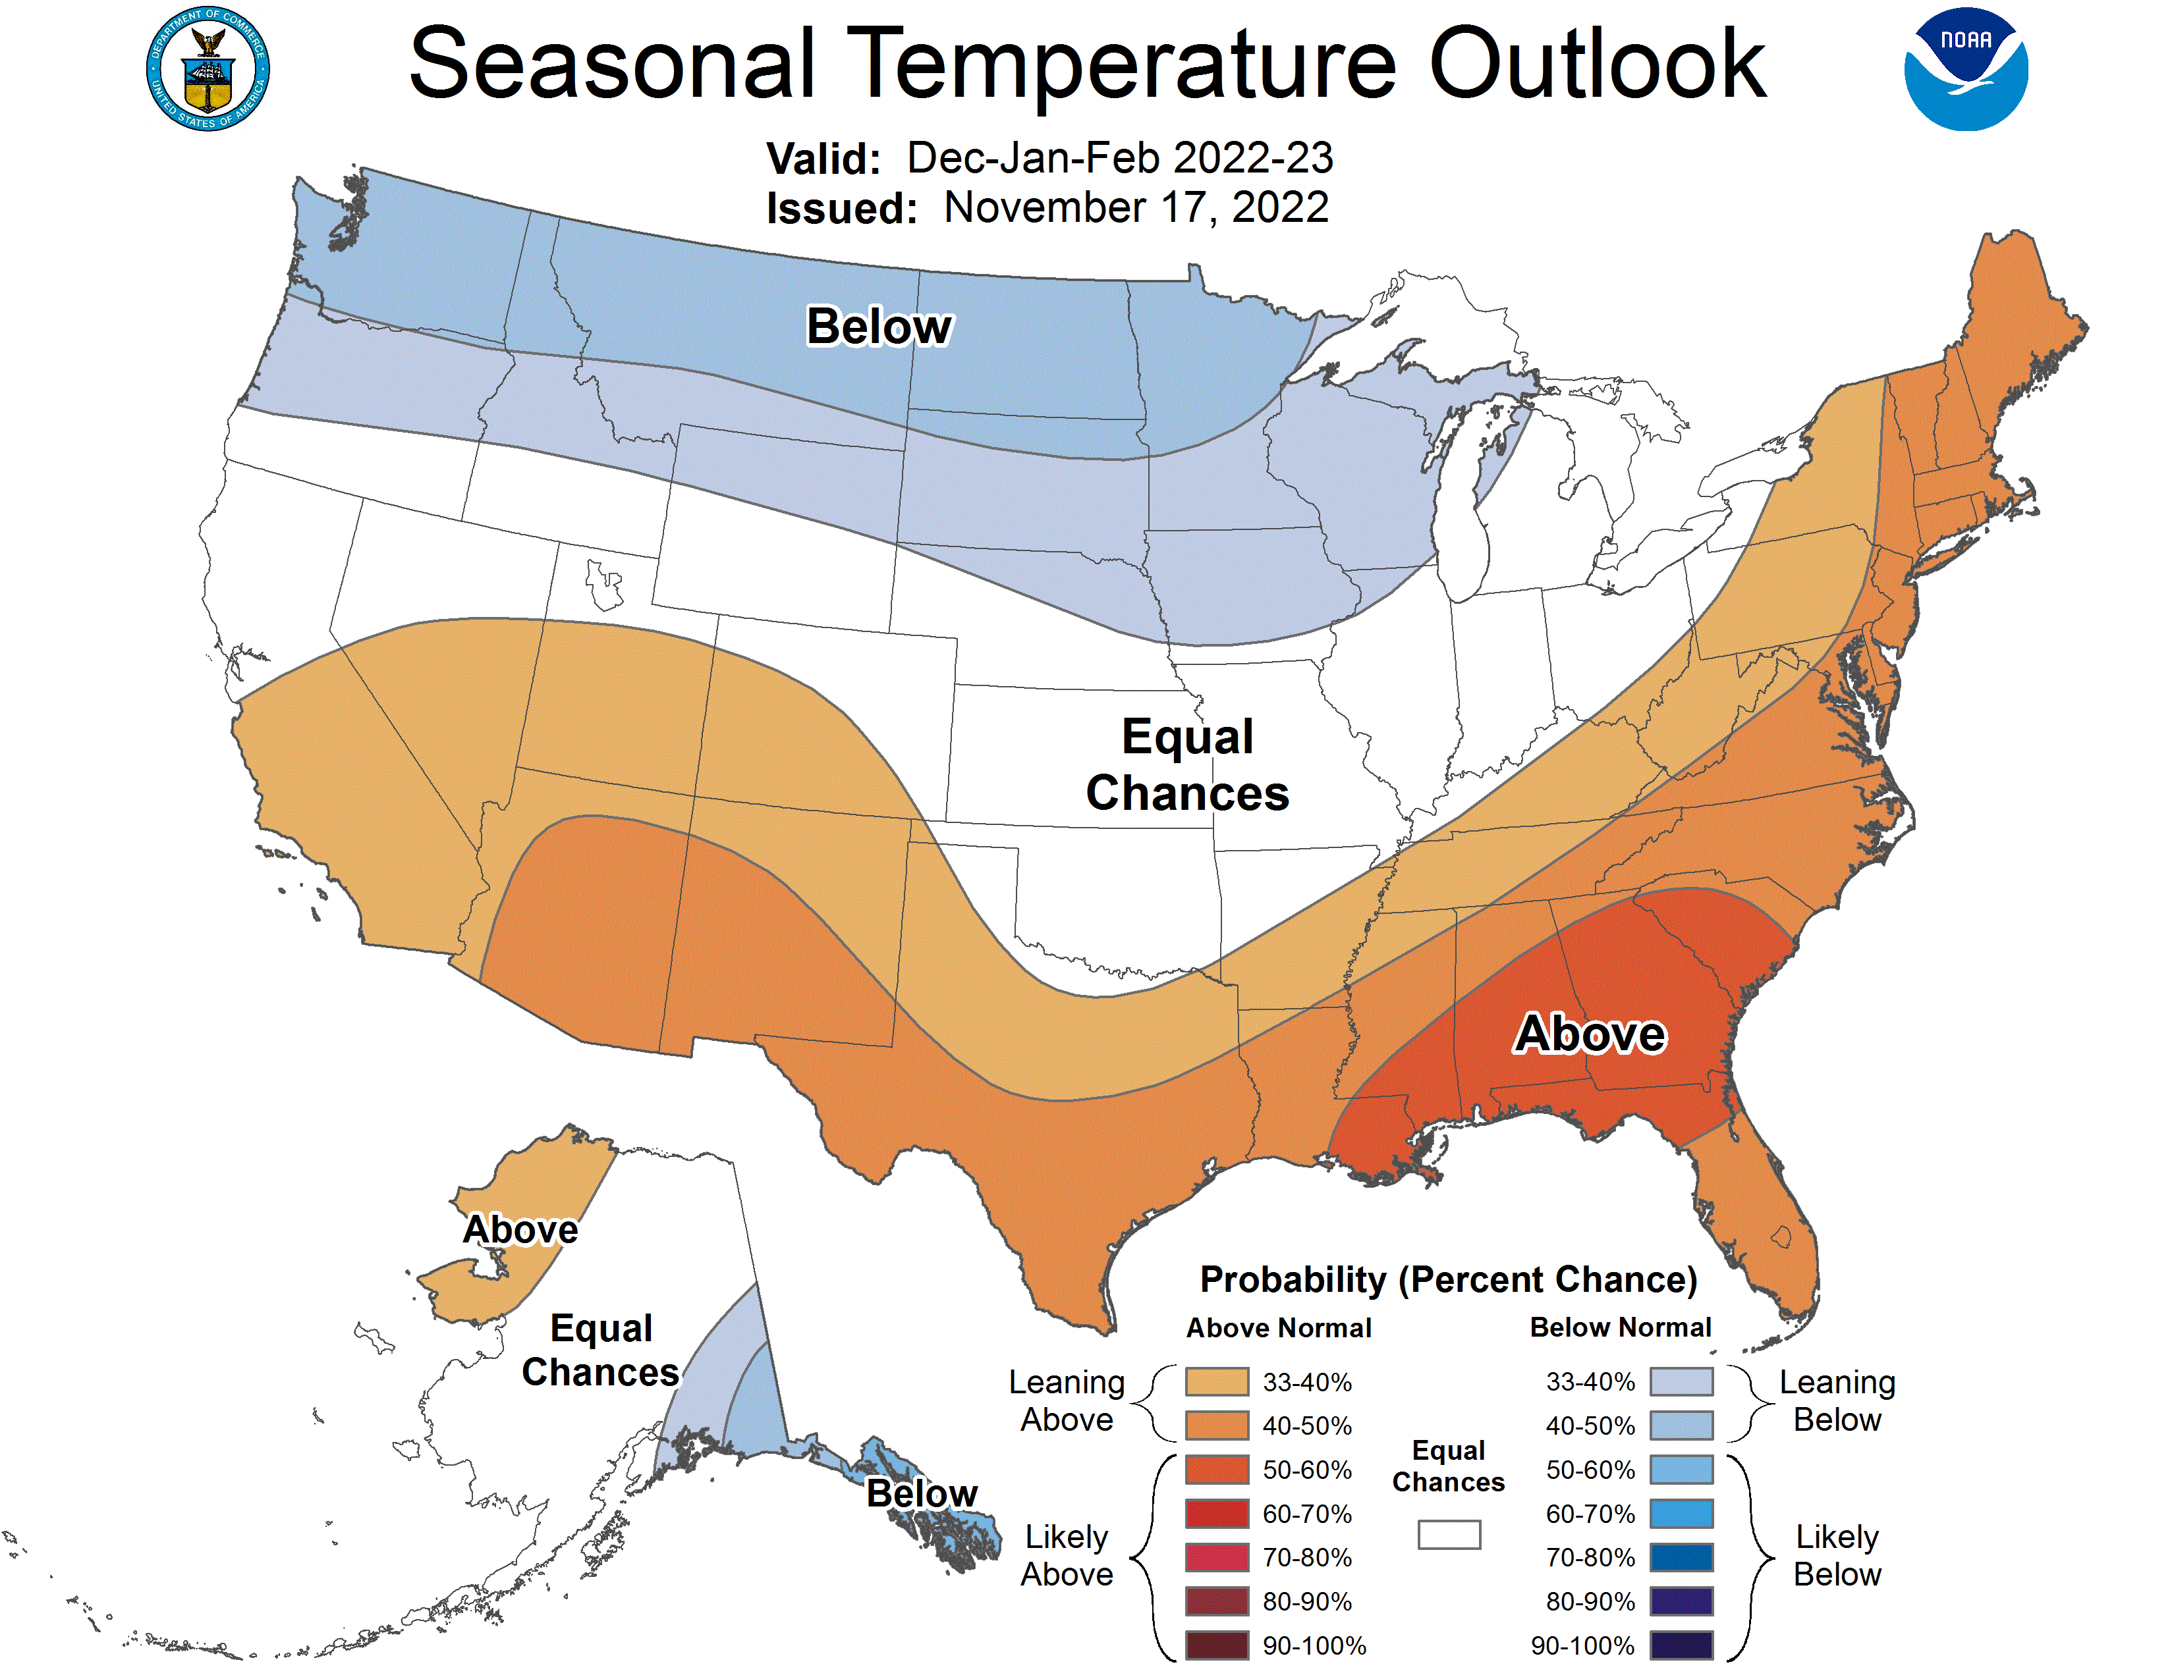
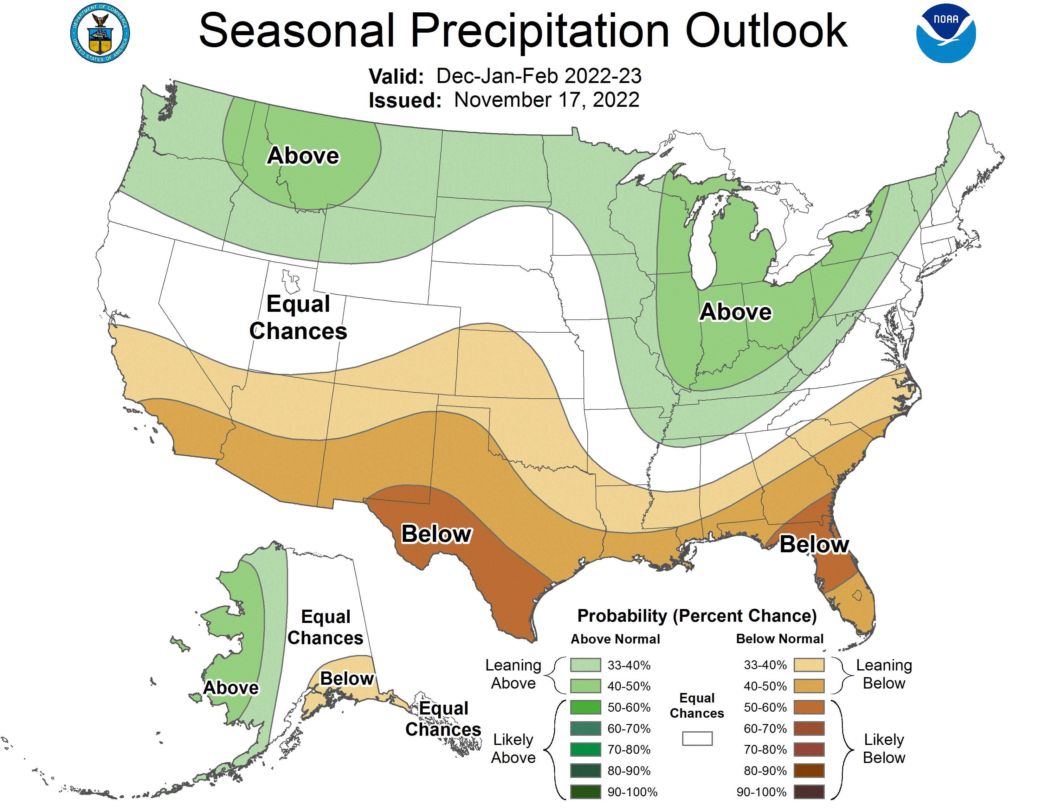
NOAA’s Official Winter Outlook

Slide 22
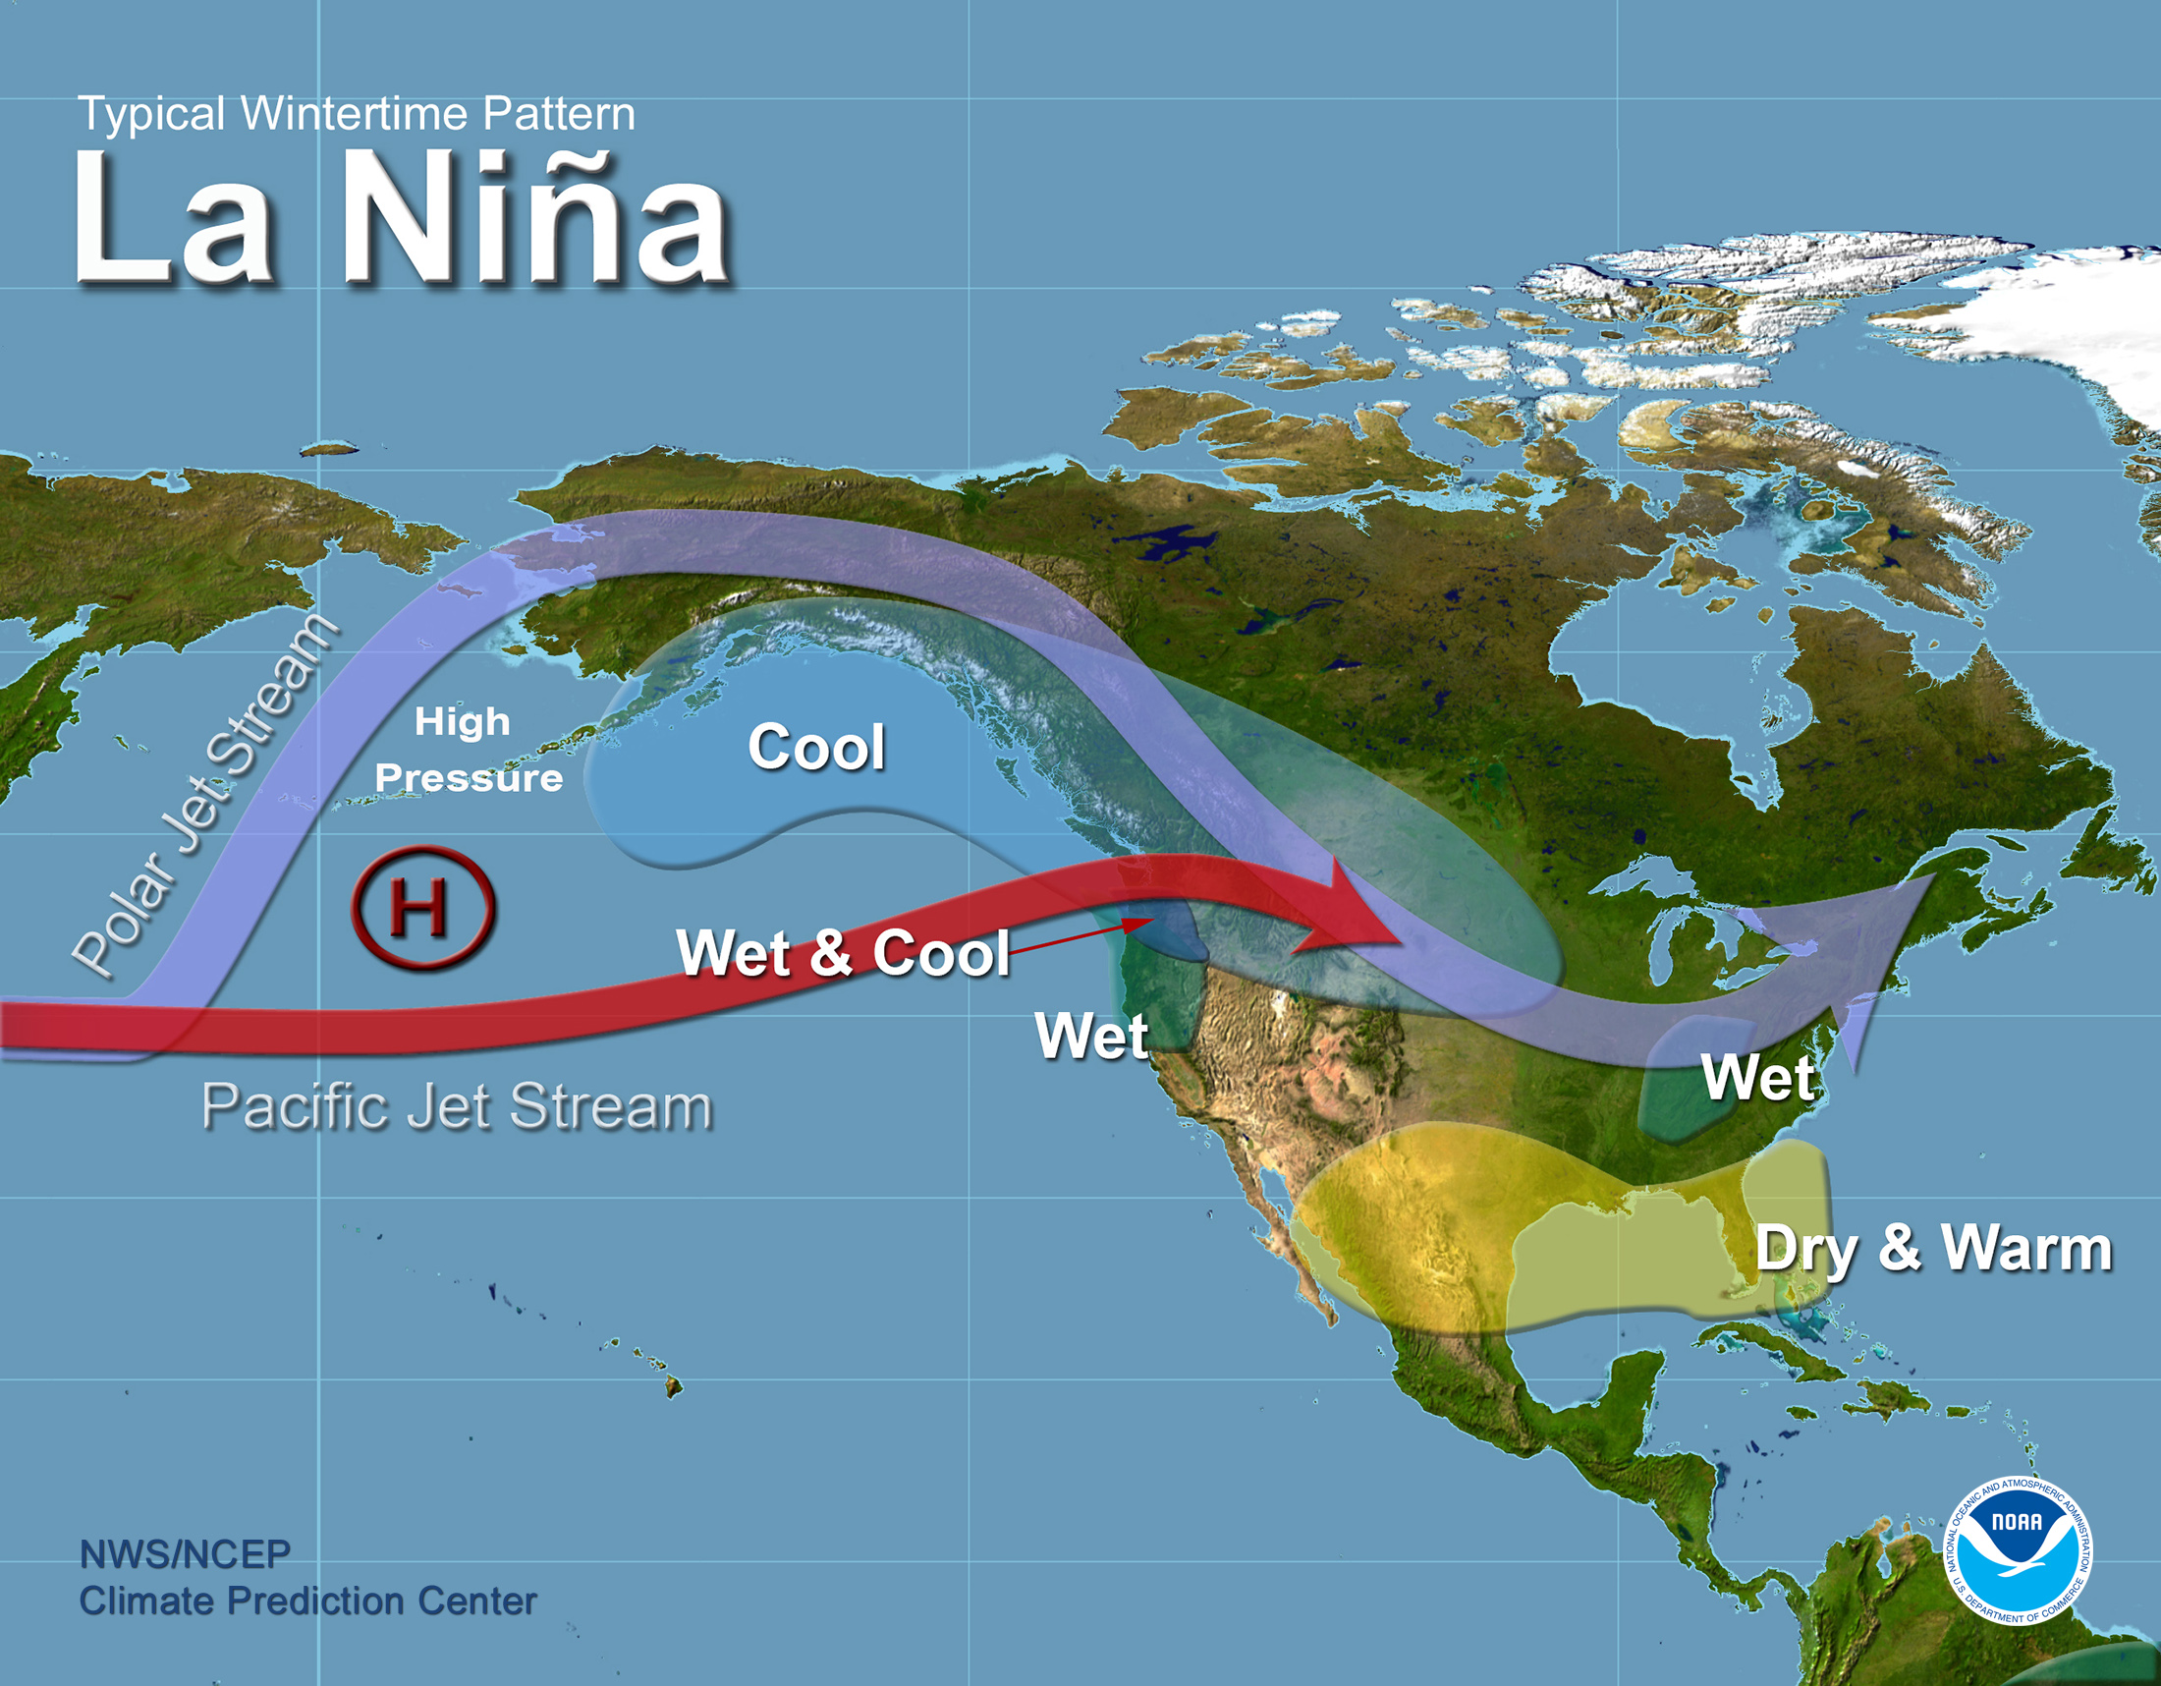
What does a typical La Nina pattern mean?
https://www.pmel.noaa.gov/elnino/sites/default/files/thumbnails/image/LaNina-Jet-Wintertime-Pattern.jpg

Slide 23
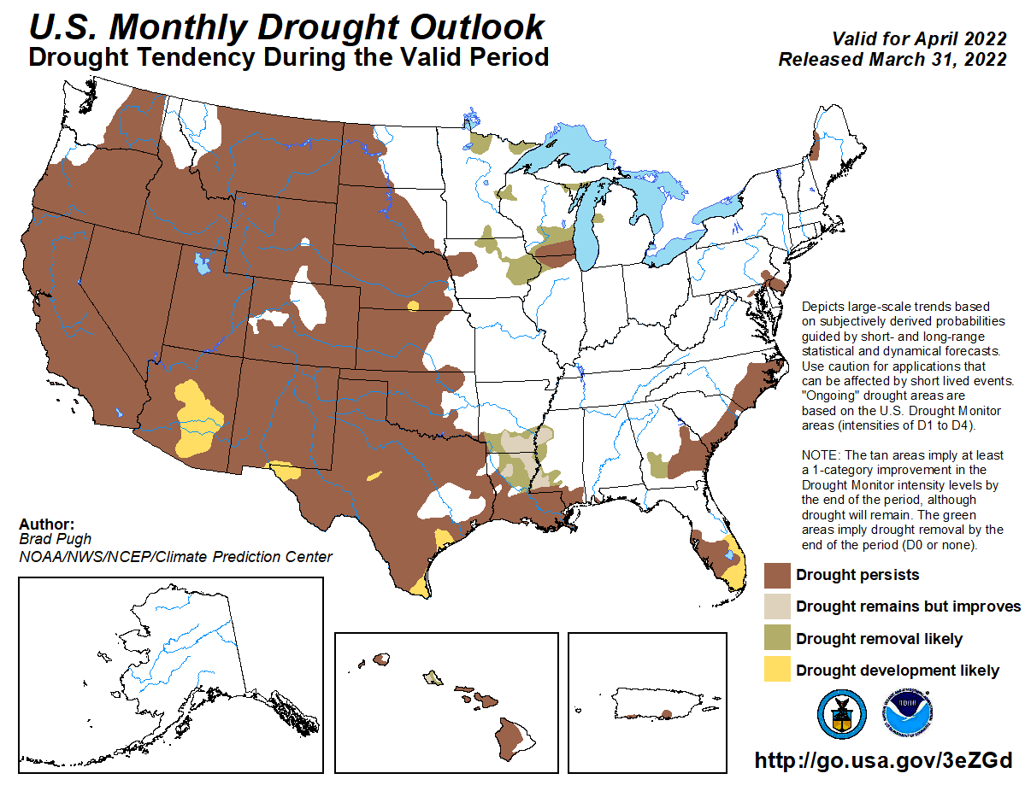

Slide 24
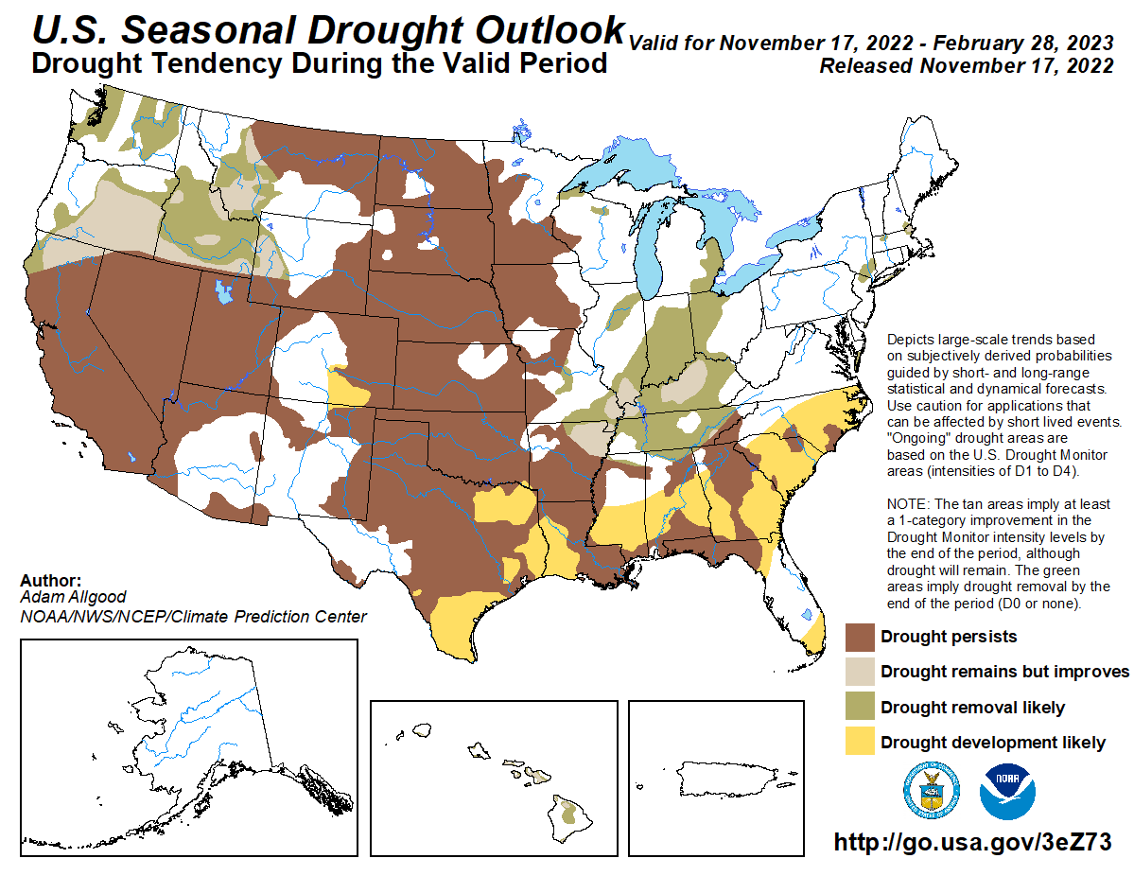

Slide 25
Climate/Drought Summary
Temperatures have been cooler than normal throughout the High Plains lately and near normal for the year so far. Over the last 60 days, most all the region was 1-2 degrees below normal.
Precipitation has been well below normal for the year. The exception is in North Dakota and portions of the Rocky Mountains that have received the most precipitation in 2022.
A second autumn with little to no soil moisture recharge will potentially be problematic during the 2023 agricultural season.
Nebraska is currently showing 99.78 percent of the state in drought with just over 85% in severe drought or worse. This compares to the last CARC meeting in April when just under 60% of the state was in severe drought or worse.
The seasonal drought outlook that goes through the end of February has current drought persisting during this time for most all the region with drought development expected to our south due to a 3rd straight La Nina winter.

Slide 26
Nebraska Water Supply Update…

Slide 27
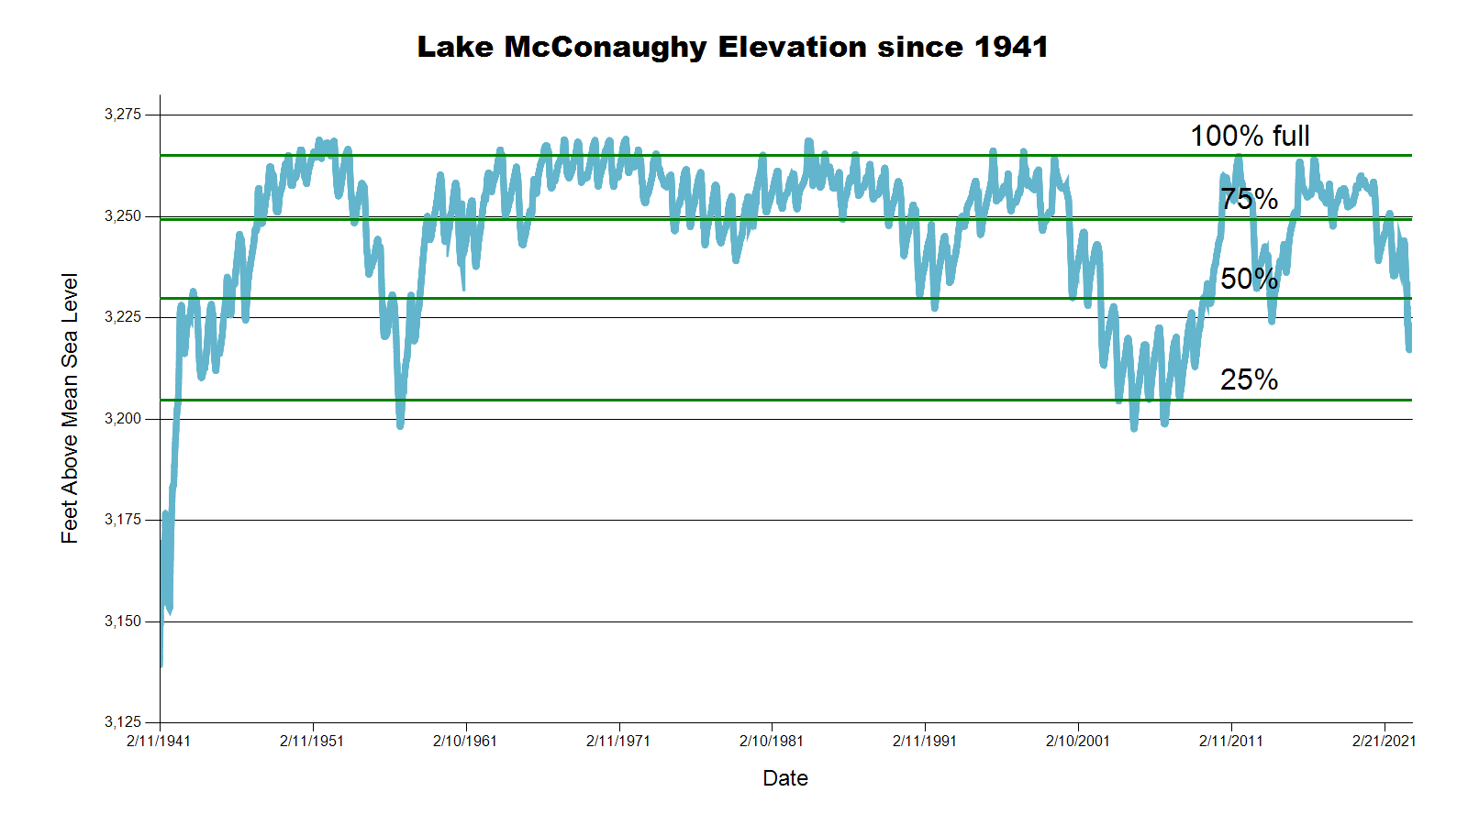
3223.2 feet 42.7% Full
SOURCE: CNPPID www.cnppid.com

Slide 28
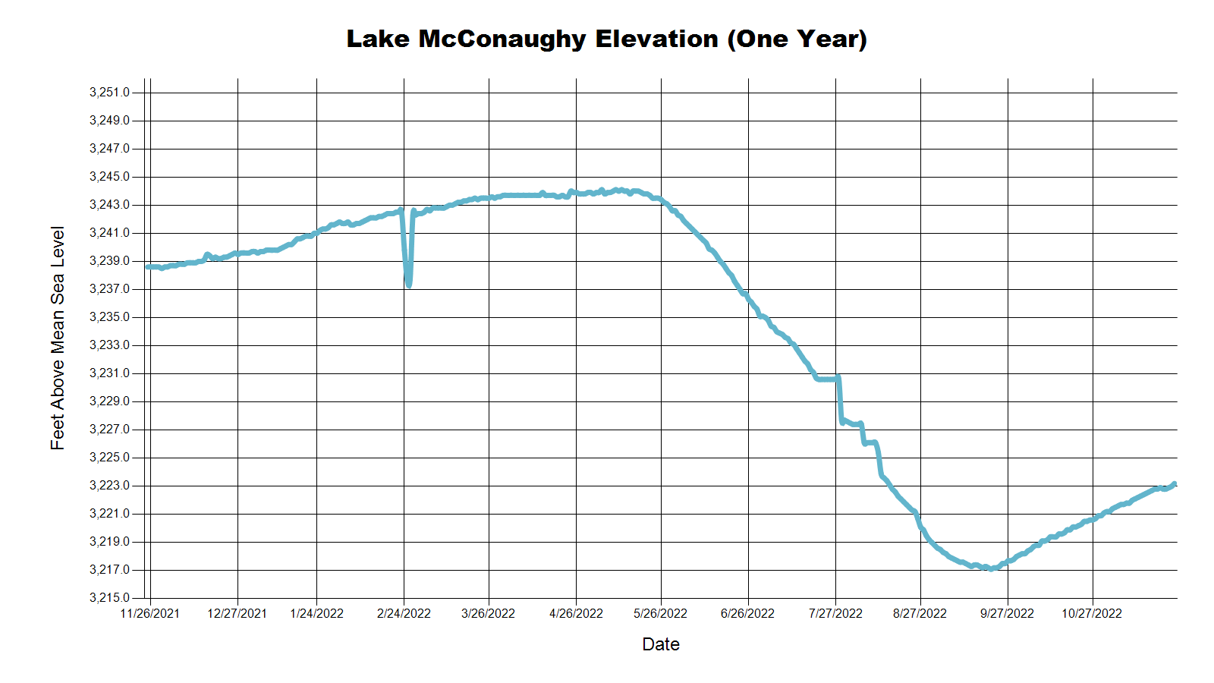
3243.7 Feet
67.2% of Max
April 2022
3238.0 Feet
59.8% of Max
November 2021
3223.2 Feet
42.7% of Max
November 2022
SOURCE: CNPPID www.cnppid.com

Slide 29
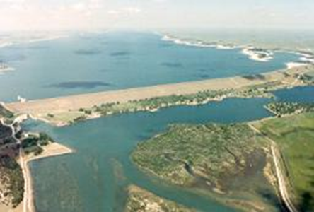
November 2022 CARC Meeting
SOURCE: CNPPID www.cnppid.com

Slide 30
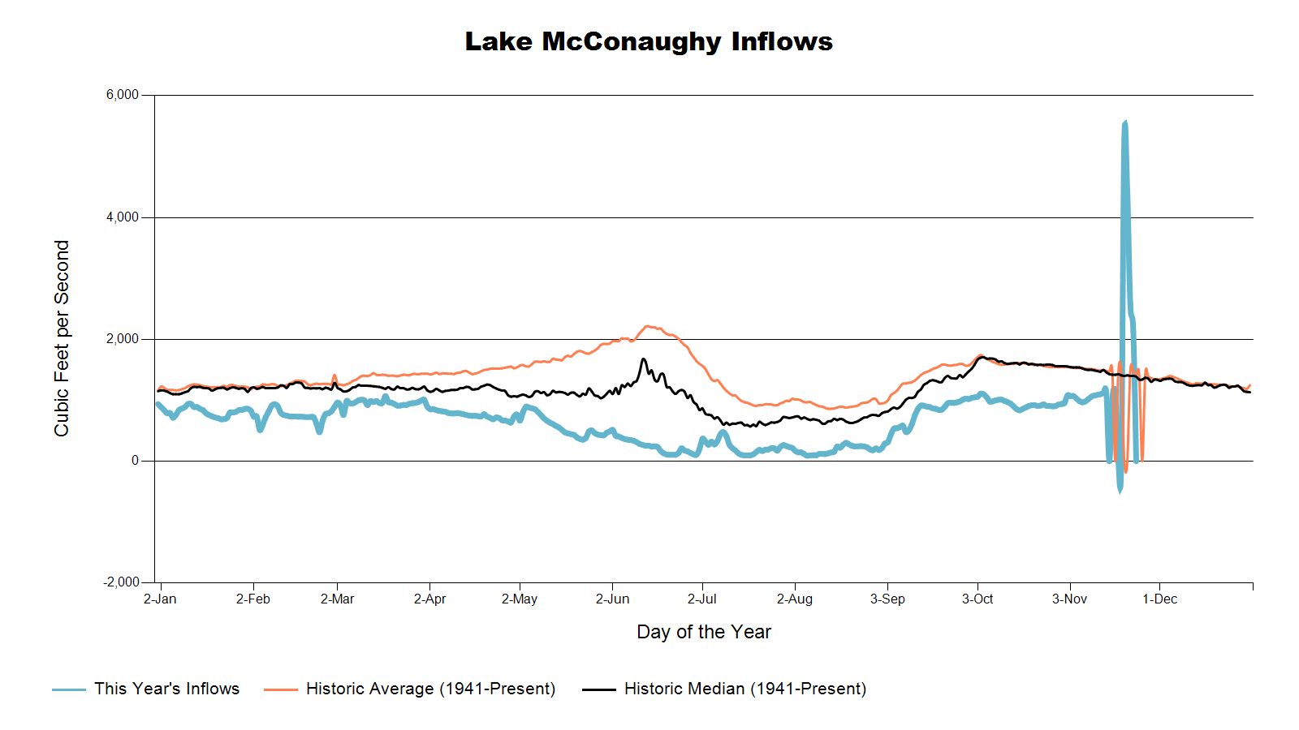

Slide 31
Lake McConaughy
Civil Engineer Tyler Thulin reported that Lake McConaughy’s elevation was at 3221.9 feet as of Monday morning (41.2% of capacity), which is up one foot in the last 10 days. Inflows are between 1,000-1,100 cubic feet per second (cfs) and outflows remain at zero while NPPD continues work on Keystone Canal gates on the east end of Lake Ogallala. The maintenance project is scheduled to be finished around Nov. 20. He added that hydrocycling at the J-2 Hydroplant will end on Nov. 10.
SOURCE: CNPPID News Release November 7, 2022
www.cnppid.com

Slide 34
North Platte Basin data
https://www.usbr.gov/gp/lakes_reservoirs/wareprts/main_menu.html#supply

Slide 35
North Platte River Basin Inflow

Slide 36
North Platte River Basin Storage

Slide 37
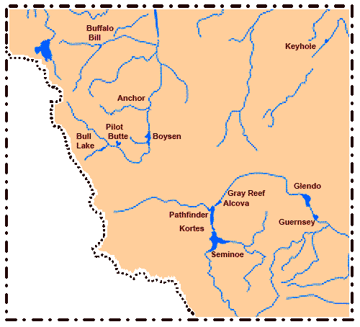
North Platte River Basin
Seminoe: 45.9% of conservation pool, 29.7% last CARC meeting
Pathfinder: 31.2% of conservation pool, 60.6% last CARC meeting
Glendo: 36.7% of conservation pool, 73.0% last CARC meeting
Alcova: 85.1% of conservation pool, 89.2% last CARC meeting
Source: BOR https://www.usbr.gov/gp/lakes_reservoirs/wyoming_lakes.html

Slide 38
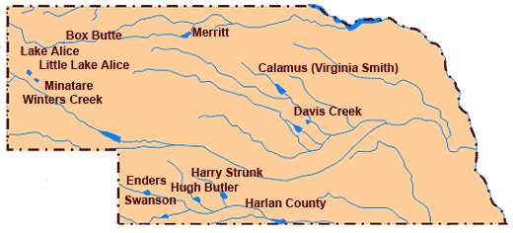
Republican River Basin
Hugh Butler: 29.1%(47.3%) of conservation pool
Enders: 14.9% (19.6%) of conservation pool
Harry Strunk: 47.3% (96.5%) of conservation pool
Swanson: N/A (47.8%) of conservation pool
*values in red are from the last CARC meeting
Source: BOR http://www.usbr.gov/gp/lakes_reservoirs

Slide 39
Republican River Basin
Harlan County Current Conditions
Conservation Pool is 71.9% full (95.2%)
225,693 Acre-Feet in storage compared to 298,901 Acre-Feet (AF) of water in storage during April 2022
Last year at this time, 276,275 AF was in storage (November 2021)
Historical average storage for this time of the year is 243,496 AF
*values in red are from the last CARC meeting
Source: BOR http://www.usbr.gov/gp/lakes_reservoirs/

Slide 40
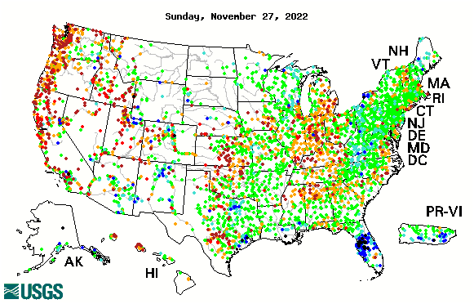

14-day average streamflow compared to historical streamflow for the day of year

Slide 41
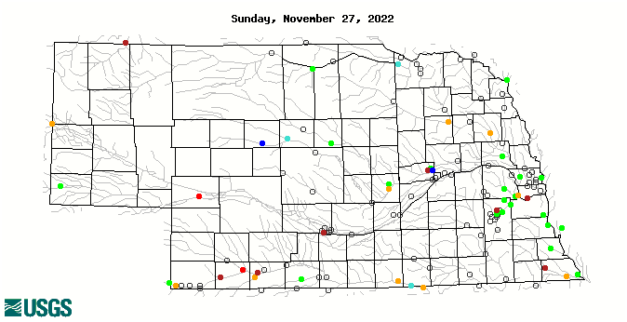
14-day average streamflow compared to historical streamflow for the day of year
9th Percentile
10th Percentile
7th Percentile
4thPercentile
3rd Percentile
10thPercentile

Slide 42
Water Supply Summary
Lake McConaughy is currently 42.7 percent of capacity and has been slowly rising since the end of the irrigation season.
Upstream reservoirs in Wyoming are near normal for this time of year with most being quite a bit lower than they were during the last CARC meeting in April.
The Republican River basin reservoirs are lower than they were in April as water levels have stabilized with the end of irrigation season and less demand and have added water during the winter months.
Harlan County Reservoir is holding about 73,000 acre-feet less water now than in April 2021 and is also about 18,000 acre-feet less than the historical average for this time of year.

Slide 43
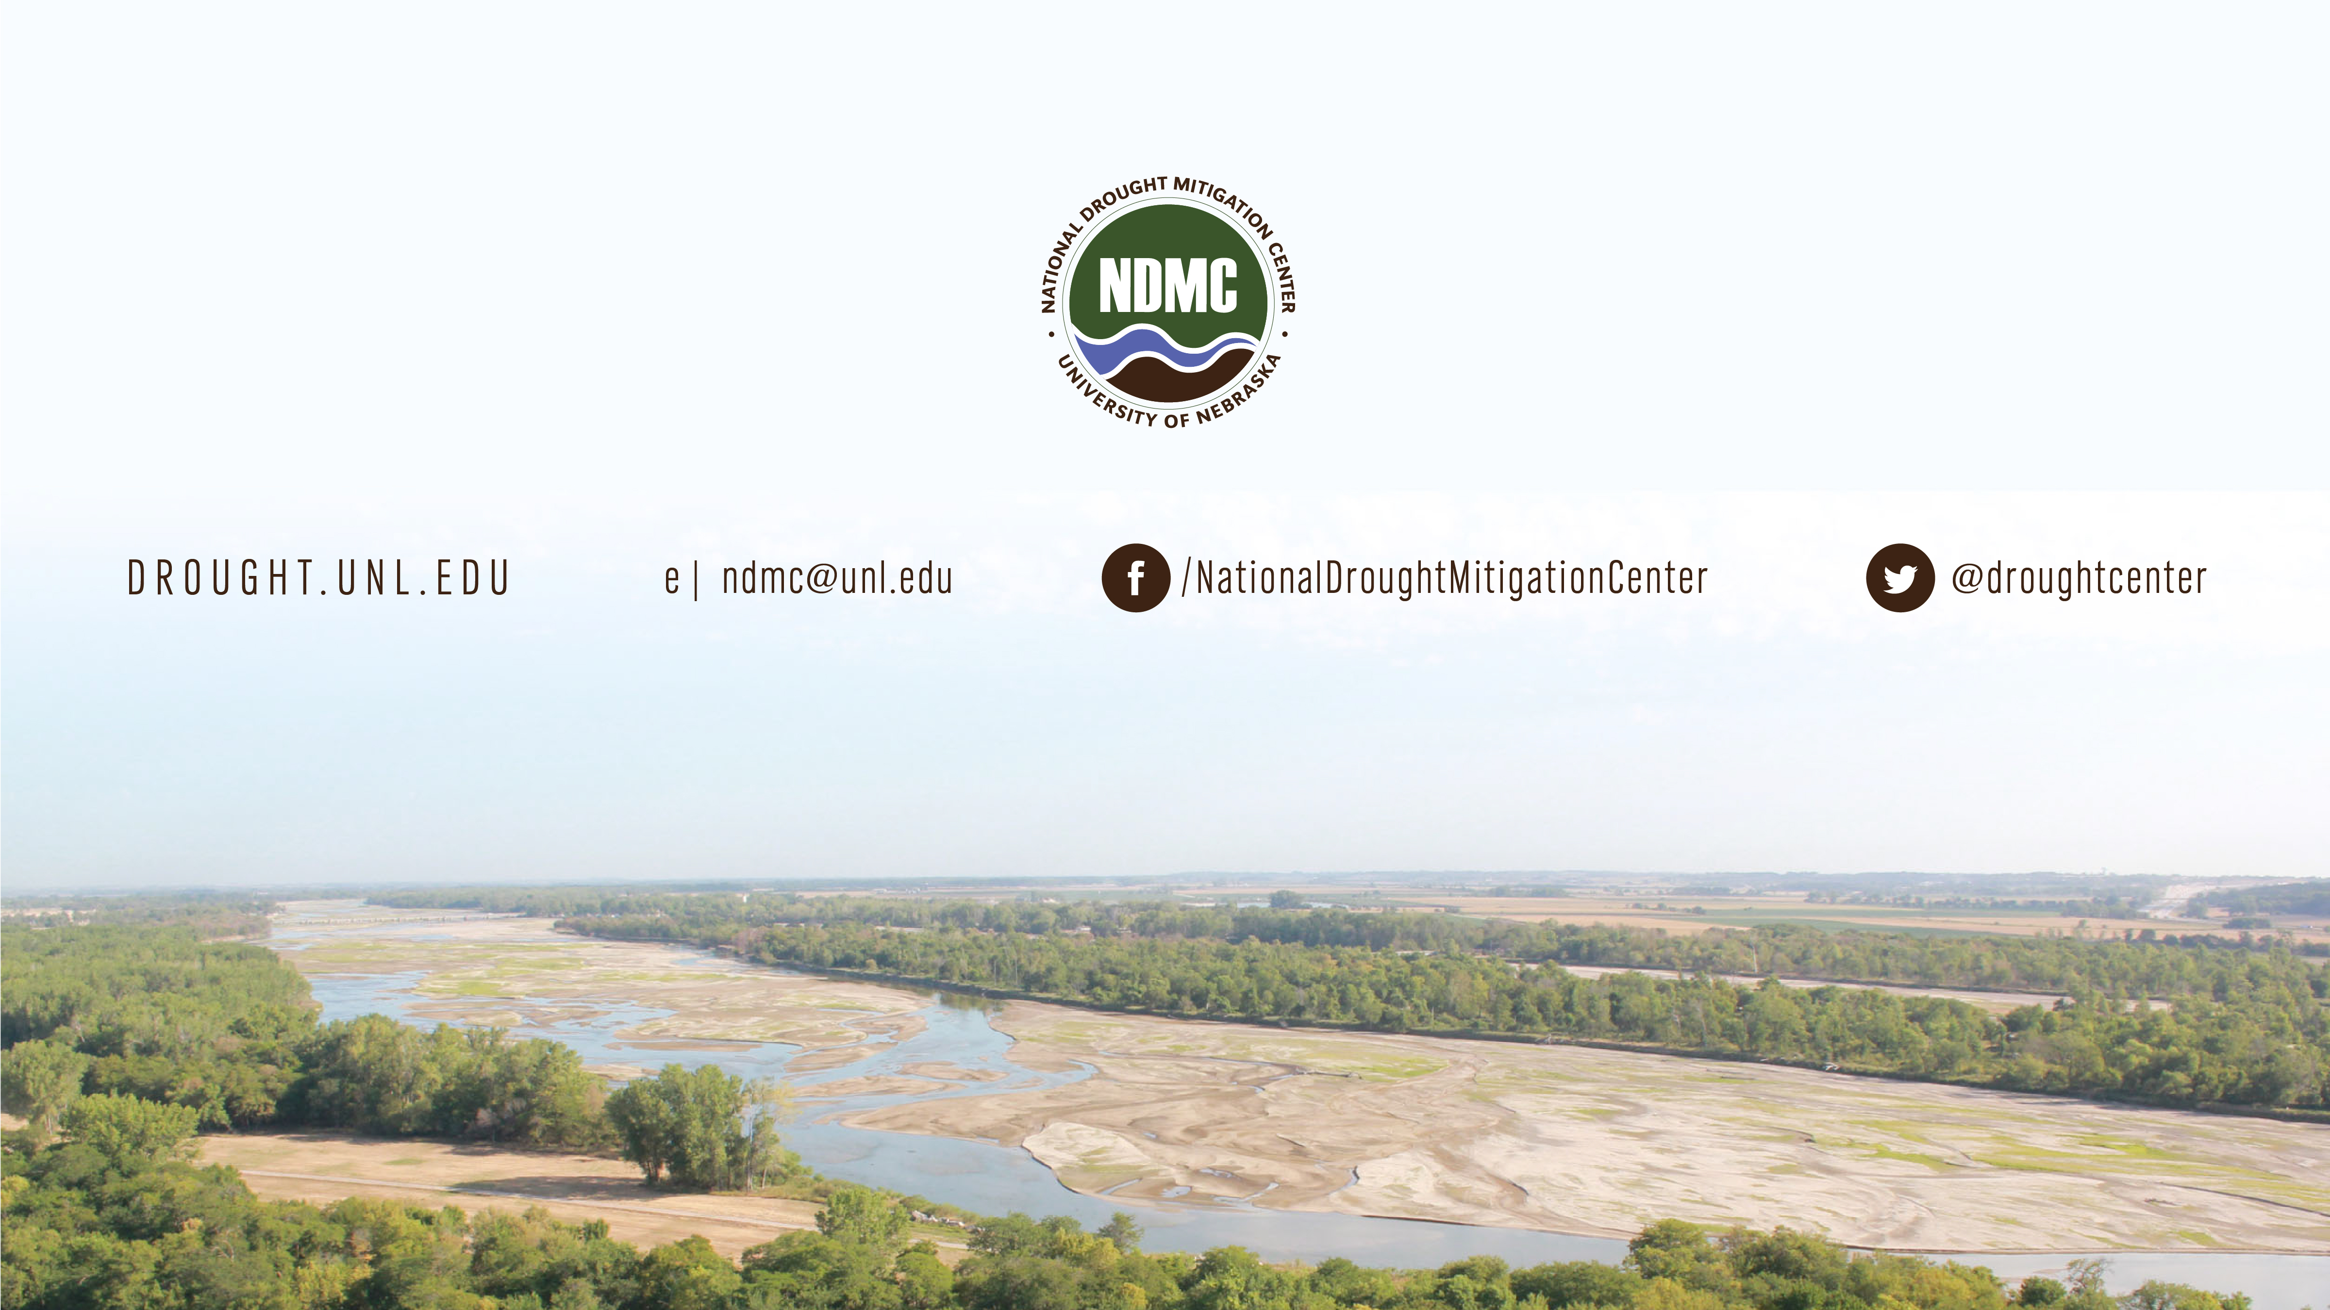
Brian Fuchs
bfuchs2@unl.edu
402-472-6775
National Drought Mitigation Center
School of Natural Resources
University of Nebraska-Lincoln

